Slide 1
The MVP Process in Chilmark and West Tisbury
Notes:
MVP Overview, Background, Climate change data, Workshop process

Slide 4
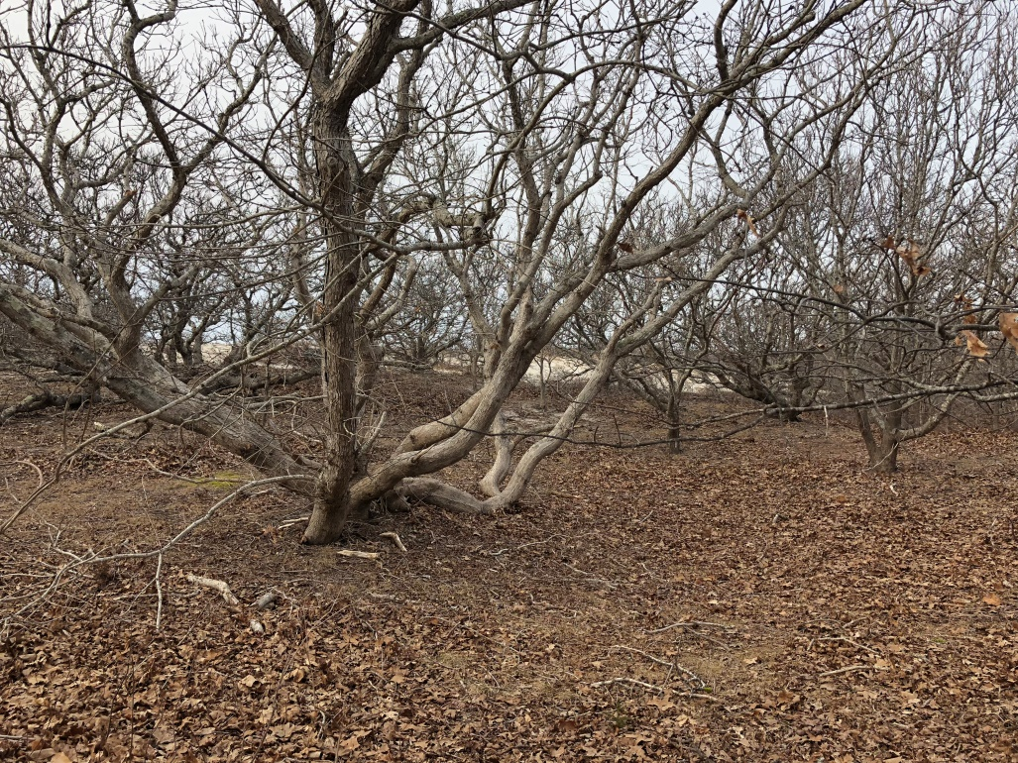
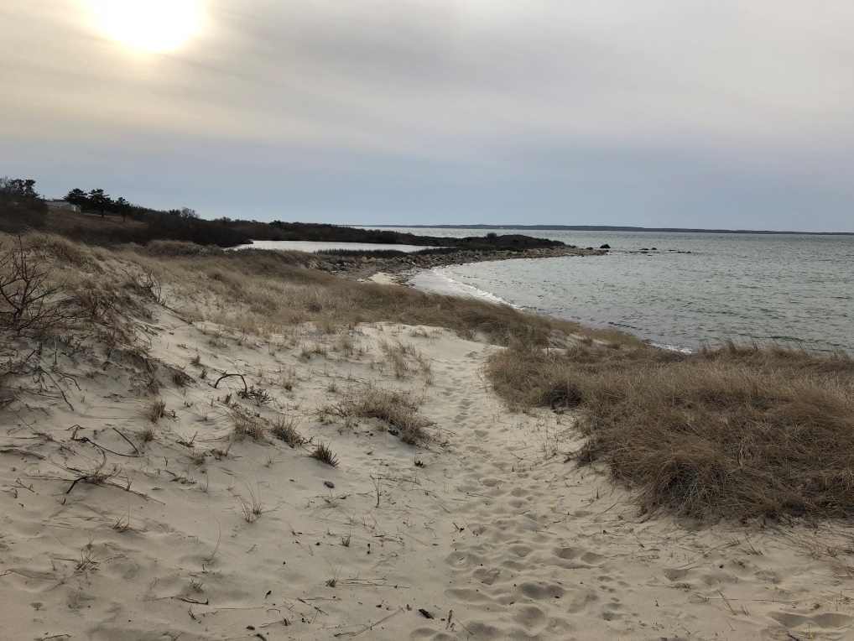
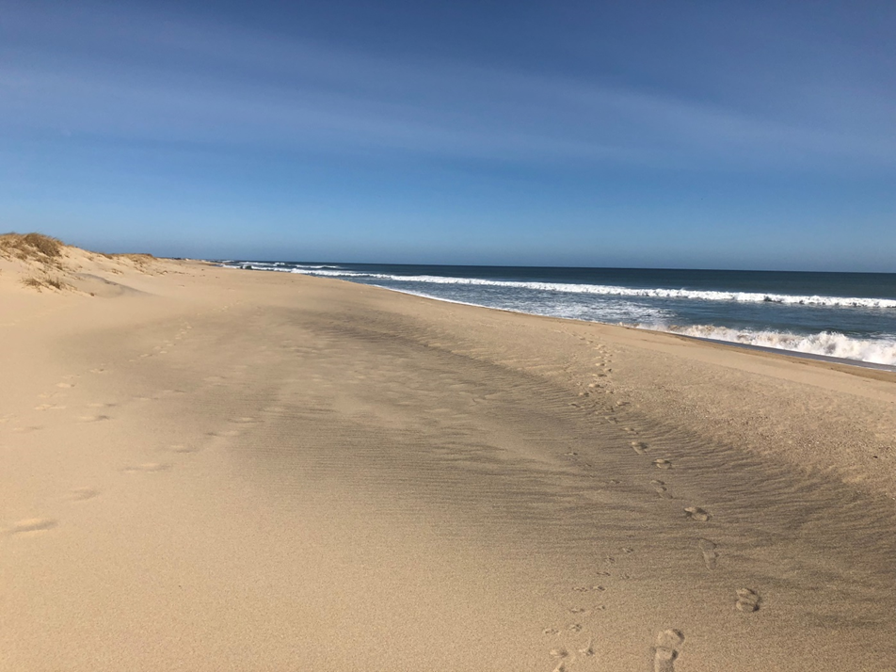

Slide 6
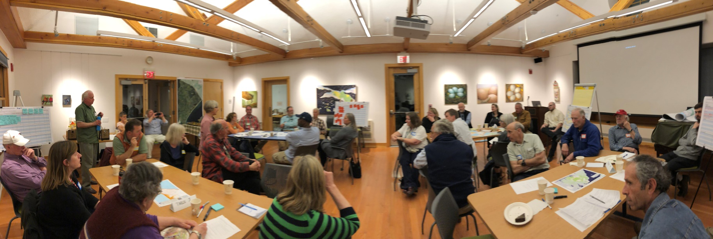
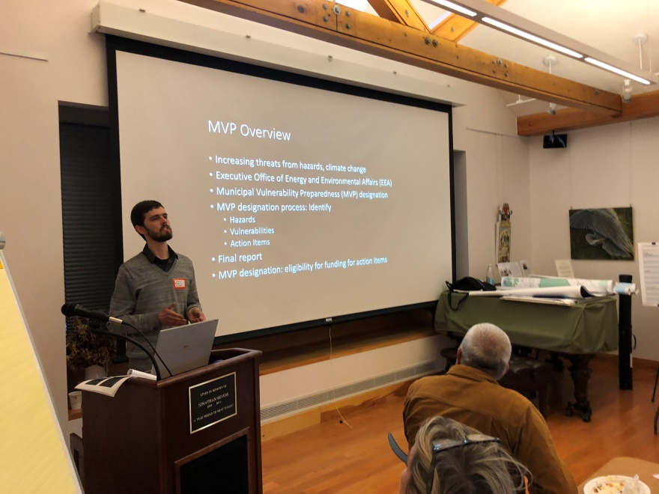
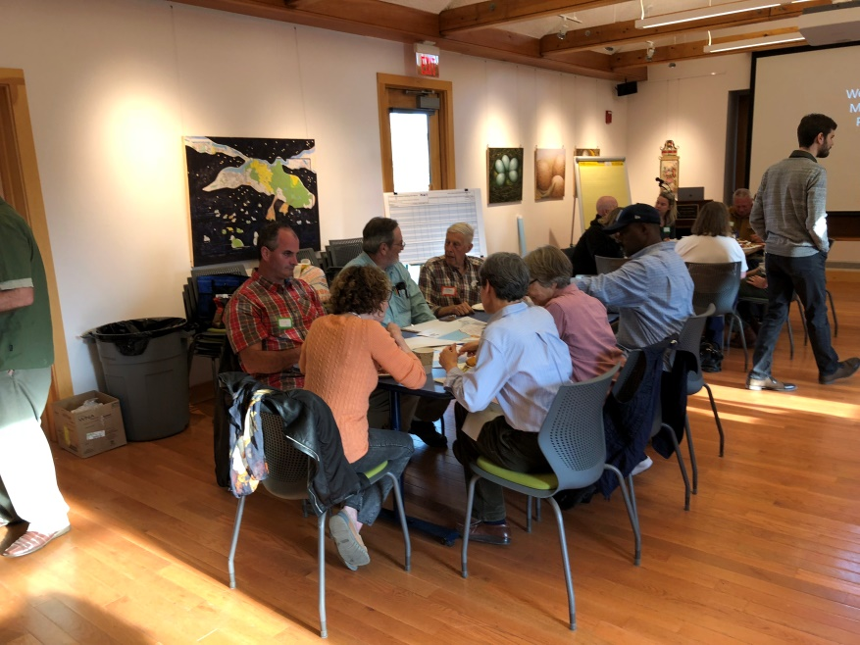
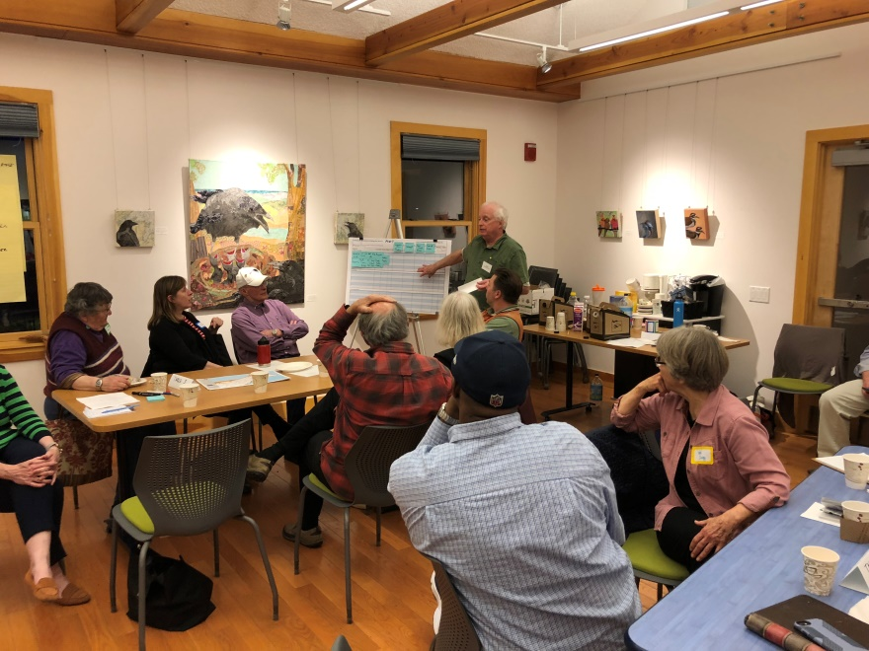
Workshop 1: Hazards and Vulnerabilities

Slide 7
Workshop 1: Hazards and Vulnerabilities
Sea level rise
Flooding and wind from hurricanes and nor’easters
Ecosystem change resulting in increased vector borne diseases (such as Lyme)
Wildfire
Drought

Slide 8
Statewide Climate Change Data

Slide 10
Expected in MA by mid-21stCentury *Relative to the 1971-2000 average
Mean annual temp 2.8-6.2°F warmer
7-26 more days per year over 90°F
19-40 fewer days below 32°F (a decline of 13-27%)
Total heating degree-days 11-24% lower
Cooling degree-days 57-150% higher
Growing degree-days 23-52% higher, and longer growing season
Notes:
What does this mean? Maybe more flooding, more erosion, also more dry periods- fire risk? Disrupted habitats and ecosystems- fisheries? Insect populations? Heat waves and ageing population..

Slide 11
Expected in Dukes County by mid-21stCentury *Relative to the 1971-2000 average
Mean annual temp 2-5°F warmer
4-15 more days per year over 90°F

Slide 12
Notes:
West Tisbury: Wildfire: About 3000 people within risk area (during summer)

Slide 13
Notes:
110 people within SLOSH category 4 (during summer)

Slide 14
Notes:
4 people within 5’ SLR

Slide 15
Martha’s Vineyard Commission’s 2015 Hazard Mitigation Plan
Identified vulnerable residents, West Tisbury:
Wildfire
About 3000 people within risk area (during summer)
Storm Surge
110 people within SLOSH category 4 (during summer)
Flooding
38 people within 100 yr flood (during summer)
Sea Level Rise
4 people within 5’ SLR

Slide 16
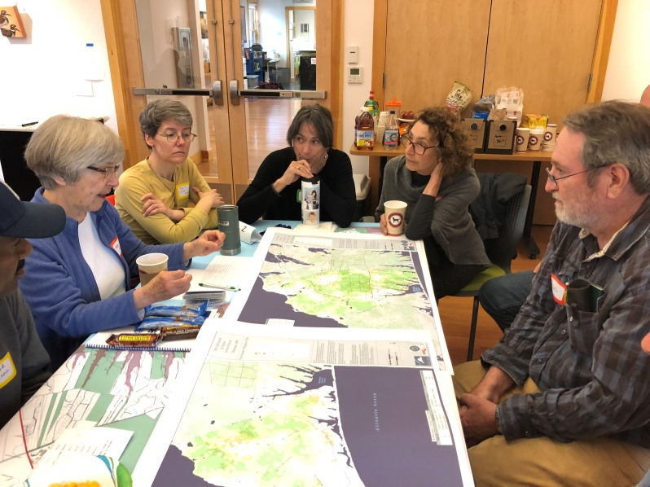
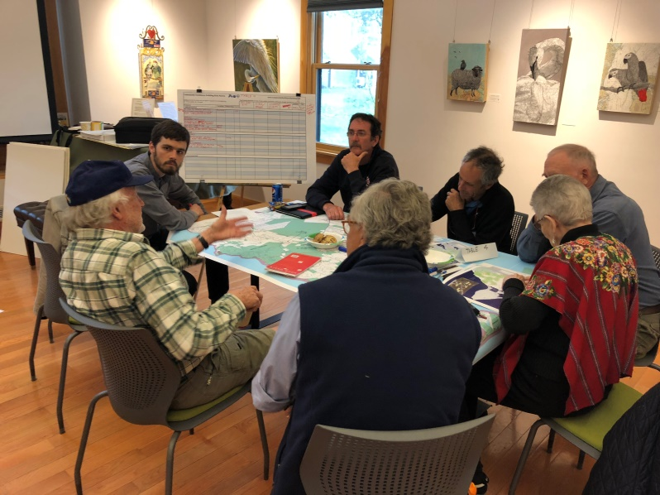
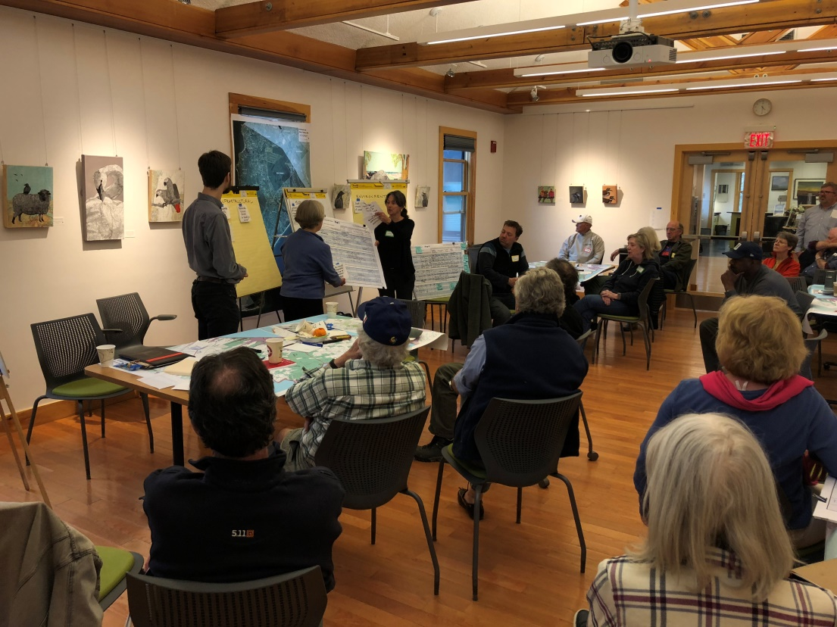
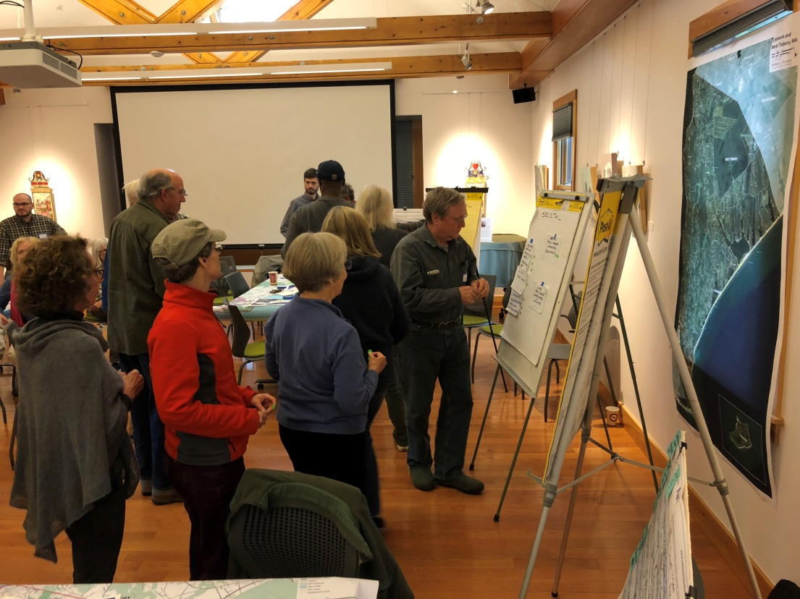
Workshop 2: Resilience Strategies

Slide 17
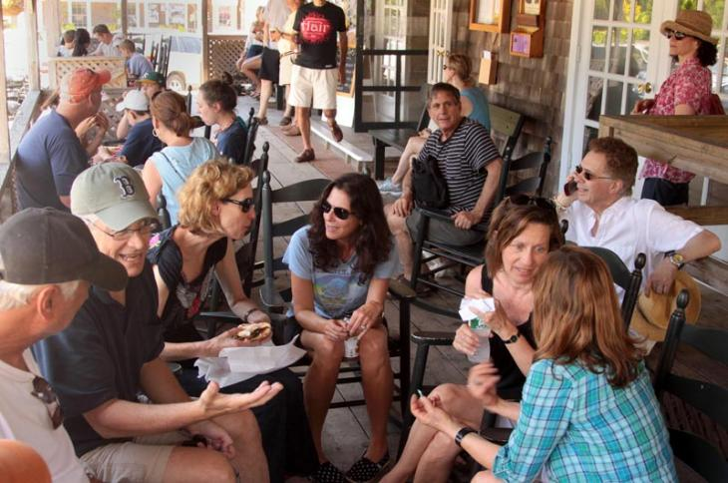
Workshop 2: Resilience Strategies
Build on Strengths:
Self-sufficiency
Vulnerable Population Plan
Public Water Supply Backup
Resilient Natural Systems

Slide 18
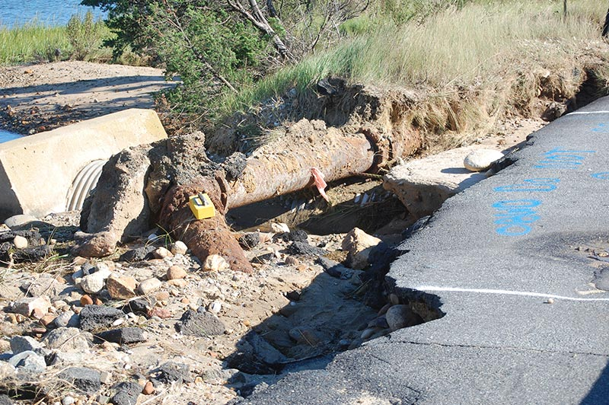
Workshop 2: Resilience Strategies
Manage Stormwater Runoff:
Update Zoning and Development Regulations
Treat Road Runoff with Green Infrastructure.

Slide 19
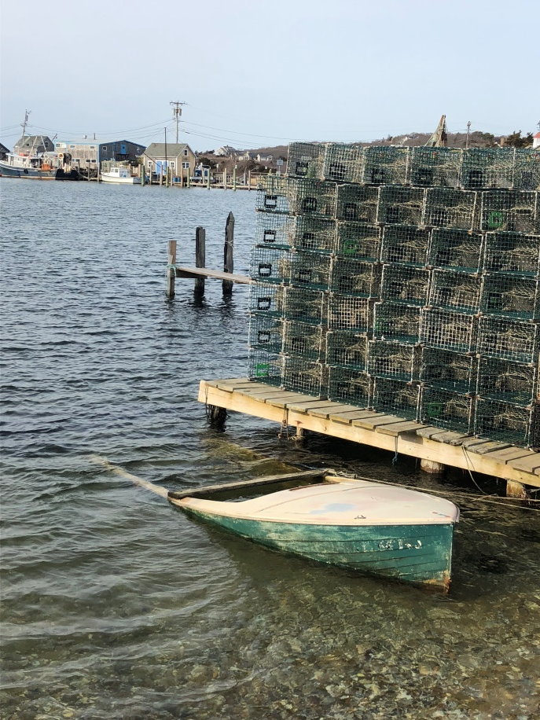
Workshop 2: Resilience Strategies
Reduce Coastal Flood Impacts:
Engineering Upgrades for certain Roads and Bridges
Protect Beach, Pond and Dune Systems

Slide 20
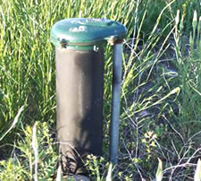
Workshop 2: Resilience Strategies
Enhance Water Supply:
Enhance Emergency Public Water Access
Expand Water Infrastructure
Install Dry Hydrants
State Forest system backup

Slide 21
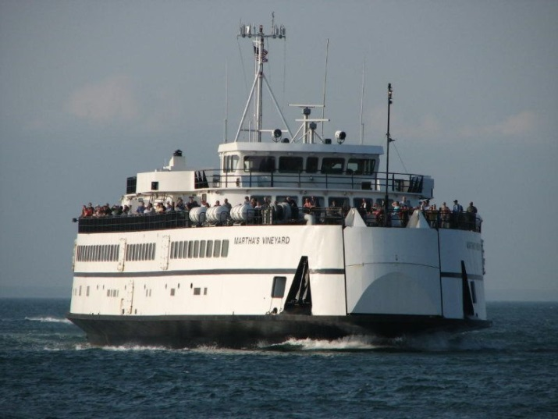
Workshop 2: Resilience Strategies
Transportation:
Improve Ferry Service
Raise Ferry Terminals to Accommodate Sea Level Rise

Slide 22
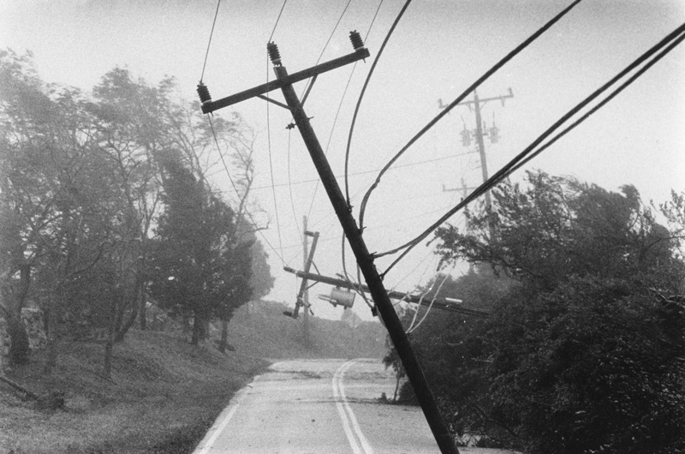
Workshop 2: Resilience Strategies
Communication and Grid:
Select Undergrounding of Power Lines
Backup Sources of Power, Cell Phone Charging etc

Slide 23
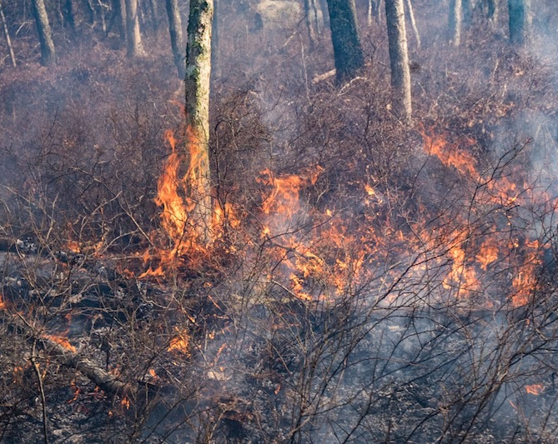
Workshop 2: Resilience Strategies
Reduce Wildfire Risk:
Forest Fuel Reduction
Forest Management Plan (including tick management)
Install Dry Hydrants
Plan for Climate Impacts

Slide 24
Workshop 2: Resilience Strategies
Public Health and Well-being:
Tick Testing Equipment
Elder Services
Home Medical Care
Communication and Outreach

Slide 25
Next Steps:
Combined, Chilmark and West Tisbury
South/State Rd Resilience Corridor
Forest Management Plan
Microgrid Plan
Public Education on Hazard Preparedness

Slide 26
Next Steps:
West Tisbury
Enhance Emergency Public Water Supply
Upgrade Subdivision Regulations for Appropriate Stormwater Management

Slide 27
The MVP Process in Chilmark and West Tisbury
Notes:
MVP Overview, Background, Climate change data, Workshop process

