Slide 1
Specialized Code Warrant Article for West Tisbury Annual Town Meeting, April 2024
To see if the Town will vote to enact Chapter XXX of the Town of West Tisbury General Bylaws, entitled “Specialized Energy Code,” for the purpose of regulating the design and construction of buildings for the effective use of energy and reduction of greenhouse gas emissions, pursuant to the entirety of 225 CMR 22 and 23 including Appendices RC and CC, including future editions, amendments, or modifications thereto, with an effective date of January 1, 2025, a copy of which is on file with the Town Clerk, or take any other action relative thereto. Definitions follow

Slide 2
Why Specialized Code for West Tisbury
Climate change is happening at a rapid rate. The Town passed a non-binding resolution committing ourselves to transitioning to all-electric from renewable sources by 2040 to help lessen our contribution to climate change. We also passed a warrant article for a Home Rule petition, asking the Legislature to allow us to require 100% electric for new construction and major renovation. While not as strong at the HRP would have been, this moves us in that direction. Passage of the Specialized Code is a prerequisite of being part of the next phase of Green Communities—the Climate Leaders program—which will offer us greater funding opportunities for green building.

Slide 3
State Climate Act 2021
The legislation signed into law updates the greenhouse gas emissions limits related to the 2008 Global Warming Solutions Act, commits Massachusetts to achieve Net Zero emissions in 2050, and authorizes the Secretary of Energy and Environmental Affairs (EEA) to establish an emissions limit of no less than 50% for 2030, and no less than 75% for 2040.
Notes:
The Stretch Energy Code (Stretch Code) regulations have since 2009 been published in MA 780CMR chapters 115.aa and previously 780 CMR 110.aa under the jurisdiction of the Board of Building Regulations and Standards.
The Climate Act of 2021 moved the authority for the Stretch Code promulgation to the Department of Energy Resources (DOER) and at the same time required the development of a new Municipal Opt-in Specialized energy code (Specialized Code). The statute requires that the Specialized Code is formulated to ensure new construction that is consistent with Massachusetts greenhouse gas limits and sub-limits set every five years from 2025 to 2050. The updated Stretch Code is divided into two chapters, following the format of the IECC and appear as new regulations in 225 CMR 22.00 and 225 CMR 23.00.

Slide 4
Building Energy Code’s role in reducing emissions
The building code is the primary policy impacting new buildings.
New buildings (built after 2023)
will represent ~27% of all building space by 2050
New buildings are easiest and cheapest to make 2050-compliant
Notes:
Within the building sector, new construction adds around 1% to the total building space each year. As the chart here shows, that means that around 27% of our expected building space in 2050 has not yet been built.
How we design and construct those buildings with respect to fossil fuels and other greenhouse gas emissions will have a massive impact on achieving our 2050 net zero mandate.
Since we literally design these buildings from the ground-up, they are far easier and cheaper to build to have net zero emissions than the work and cost of renovating our existing (and in many cases historic) buildings.
In addition to being the buildings that we can most easily build and operate without fossil fuels, the techniques, materials and equipment used to build new buildings to net-zero provides the scale to drive down the costs of retrofit work in existing buildings. For example, as we grow the supply chain for heat pumps for new buildings, that also reduces the cost and increases the number of skilled contractors to install heat pumps in existing building renovations.

Slide 5
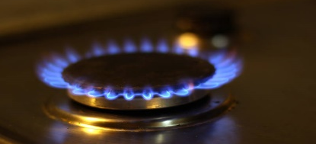
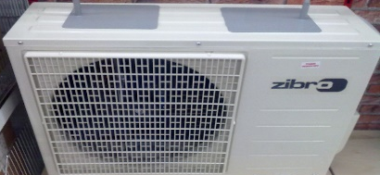
Does reliance on electricity cause greater GHG emissions?
2020
Current grid emissions:
~680 lbs/MWh
OIL
PROPANE
GAS
ELECTRIC
RESISTANCE
ELECTRIC
COLD CLIMATE
AIR SOURCE
HEAT PUMP
ELECTRIC
GROUND SOURCE
HEAT PUMP
Pounds of emissions to deliver 1 MMBtu of heat
170
145
120
205
65
45
45% Less
Notes:
If we look at the emissions is takes to heat a space using various methods – oil, propane, gas, electric resistance, electric heat pump – electric heat pump today has 45% lower emissions than natural gas.

Slide 6
With the addition offshore wind, solar and battery storage…
2050
ELECTRIC
GROUND SOURCE
HEAT PUMP
Future grid emissions:
~200 lbs/MWh
OIL
PROPANE
GAS
ELECTRIC
RESISTANCE
ELECTRIC
COLD CLIMATE
AIR SOURCE
HEAT PUMP
Pounds of emissions to deliver 1 MMBtu of heat
170
145
120
205
59
65
18
45
13
85% Less
Notes:
However, that’s just today – by 2050 with emissions at 200 lbs/MWhr – emissions of heat pumps will be almost 90% less than natural gas.

Slide 7
Base, Stretch, and Specialized – 3 Levels
Specialized Code
(Stretch code + additions)
Stretch Code (IECC 2021+ MA amendments)
This is West Tisbury now
Base Code (IECC 2018 + MA amendments)
New construction for non-GC municipalities
50 municipalities
New construction only
New construction, major renovations/additions for GC municipalities and adopters
270 municipalities
31 municipalities so far including Aquinnah
Notes:
Michael is going to go from here. THIS MIGHT CHANGE AFTER MONDAY.
International Energy Conservation Code
Amherst Carlisle Chelmsford Needham

Slide 8
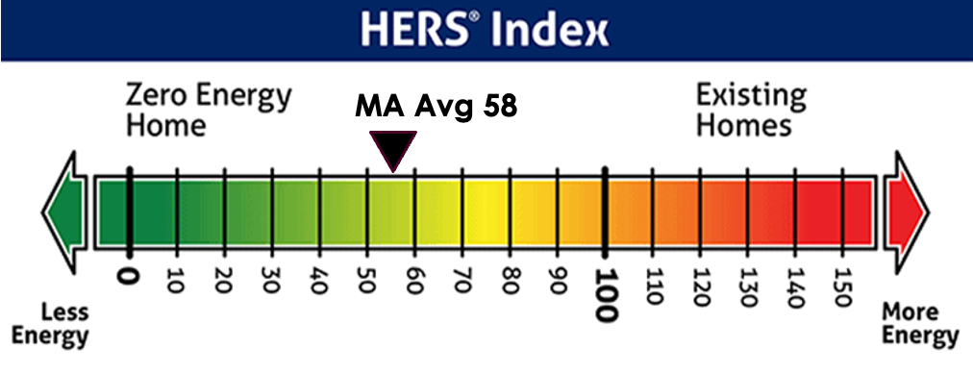
The HERS Index Rates a Building’s Efficiency current MA average is HERS 51
HERS Index: Nationally-recognized standard to measure a home’s energy efficiency taking into account the building envelope: levels of insulation and air tightness, quality of windows and doors and HVAC systems.
This metric is used for the Stretch Code as well.
HERS raters do the analysis of a building’s performance.
It does not add to our Building Inspector’s work.

Slide 9
Specialized vs Stretch code - Residential Low-Rise HERS is Home Energy Rating System. Current average in MA is HERS 51.
Energy Source(s) | Home Size | Stretch code (July 2024) | Specialized Code (Jan 2025?)
All Electric New Homes | Any Size home | HERS 45 or Passive house | No changes - HERS 45 or Passivehouse
Mixed-Fuel New Homes- use fossil fuels for any of these: heating, hot water, cooking… | Under 4,000 sq ft | HERS 42 | +Solar PV (min 4kw) + wiring for electrification
Multi-family (4+ stories & over 12,000 sf) | 4,000 sq ft and over | HERS 42 | + Solar PV (to net-zero) + wiring for electrification
 | Any | Passive house option | + wiring for electrification
Home additions & alterations | Any | Same as Stretch code
Historic or Existing homes | Any | Energy Code exemption if it would damage the historic fabric of the building

Slide 10
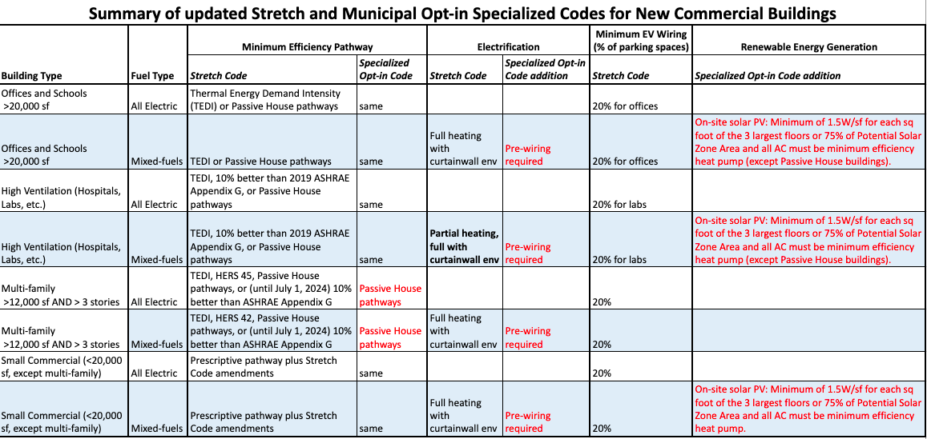

Slide 11
Mixed Fuel Option: Allows Choice, Future Proof
MA likely to ban fossil fuels in the future. Pre-wiring makes future retrofits easier and cheaper
Specialized Code encourages All Electric but allows Fossil Fuels.

Slide 12
Increased Incentives for builders & developers
All-electric homes are generally cheaper to build
Heat Pump(s) replaces both Central A/C + Furnace(s)
With climate change, more people want AC than before
Incentives:
Mass Save: 1-4 unit all-electric homes
$15,000 for HERS 45 single-family
$25,000 for HERS 35 / Passive House single-family
Mass Save: multi-family Passive house
$3,000 per unit plus design study funding
Federal IRA:
$2,500 or $5,000/home from 45L tax credit: (aligned with HERS)
up to $6/sqft from 179D tax credit for commercial & multi-family
https://www.masssave.com/saving/residential-rebates/all-electric-home
https://www.masssave.com/saving/residential-rebates/passive-house-incentives

Slide 13
FAQs
Will I have to cut down trees to install rooftop solar? | No. Homes are exempt where solar access is less than 70% or the roof is too steep.
Will our island grid be ready? | Yes. Eversource will be adding one more cable and replacing one cable in 2025. They say these two new cables will provide 140% more than what they predict we need in 2050, with the transition away from fossil fuels.
What about backup power? | You can install a fossil fuel backup generator on an “All-Electric” home.

Slide 14
We have been a Green Community since 2011. This allow us to join the new DOER Climate Leaders Program-- a step up with greater funding from Green Communities
Provides access to grant funding to a municipality to support all or a portion of the cost of: Studying, designing, constructing and implementing energy efficiency activities including energy efficiency measures and projects procuring energy management services adopting energy efficiency policies siting activities related to and construction of renewable energy generating facilities on town owned property. To be eligible for certification, we must meet the following requirements: Be a Green Community in good standing Have a local body (energy committee) that advises the Town on clean energy/climate initiatives Commit to eliminate on-site fossil fuel use by 2050 (municipal buildings/operations) Create a municipal decarbonization roadmap Adopt a Zero-Emission Vehicle first policy Adopt the Specialized Opt-In building code

