Slide 1
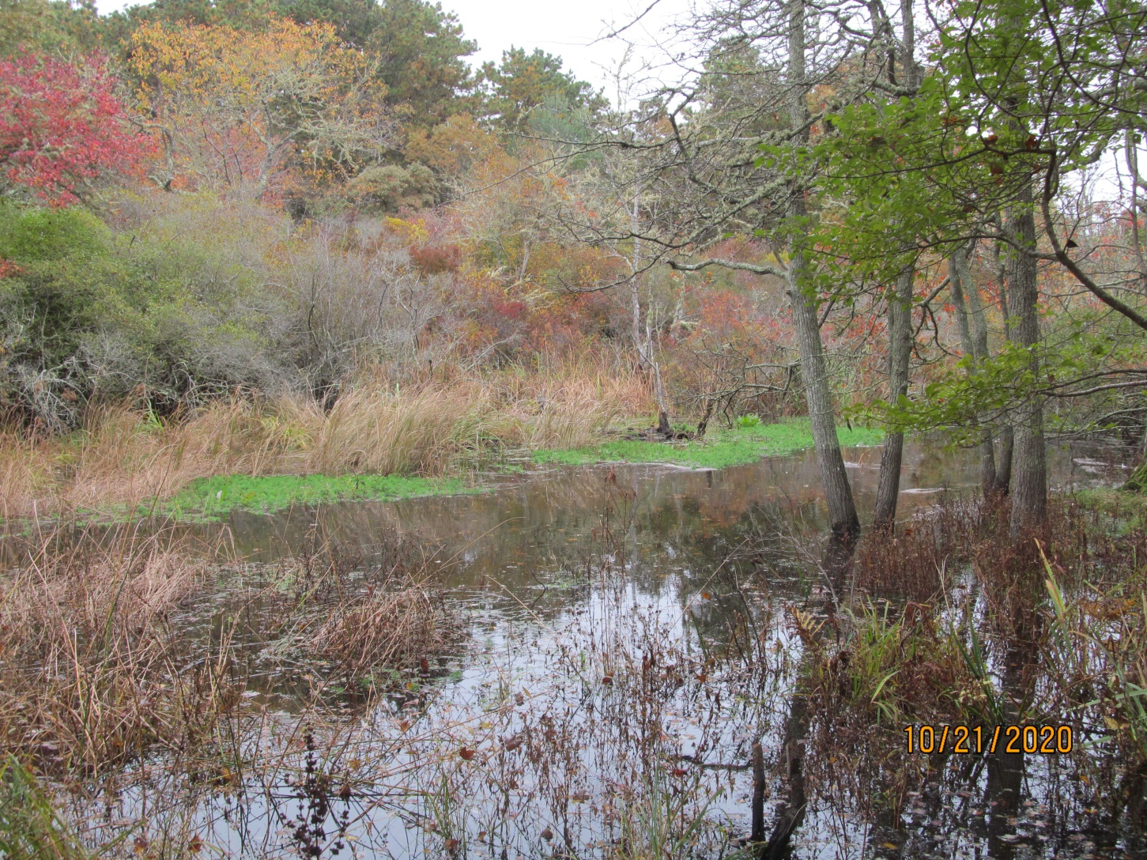
Pear Tree Cove
October 21, 2020
Parrot Feather

Slide 2
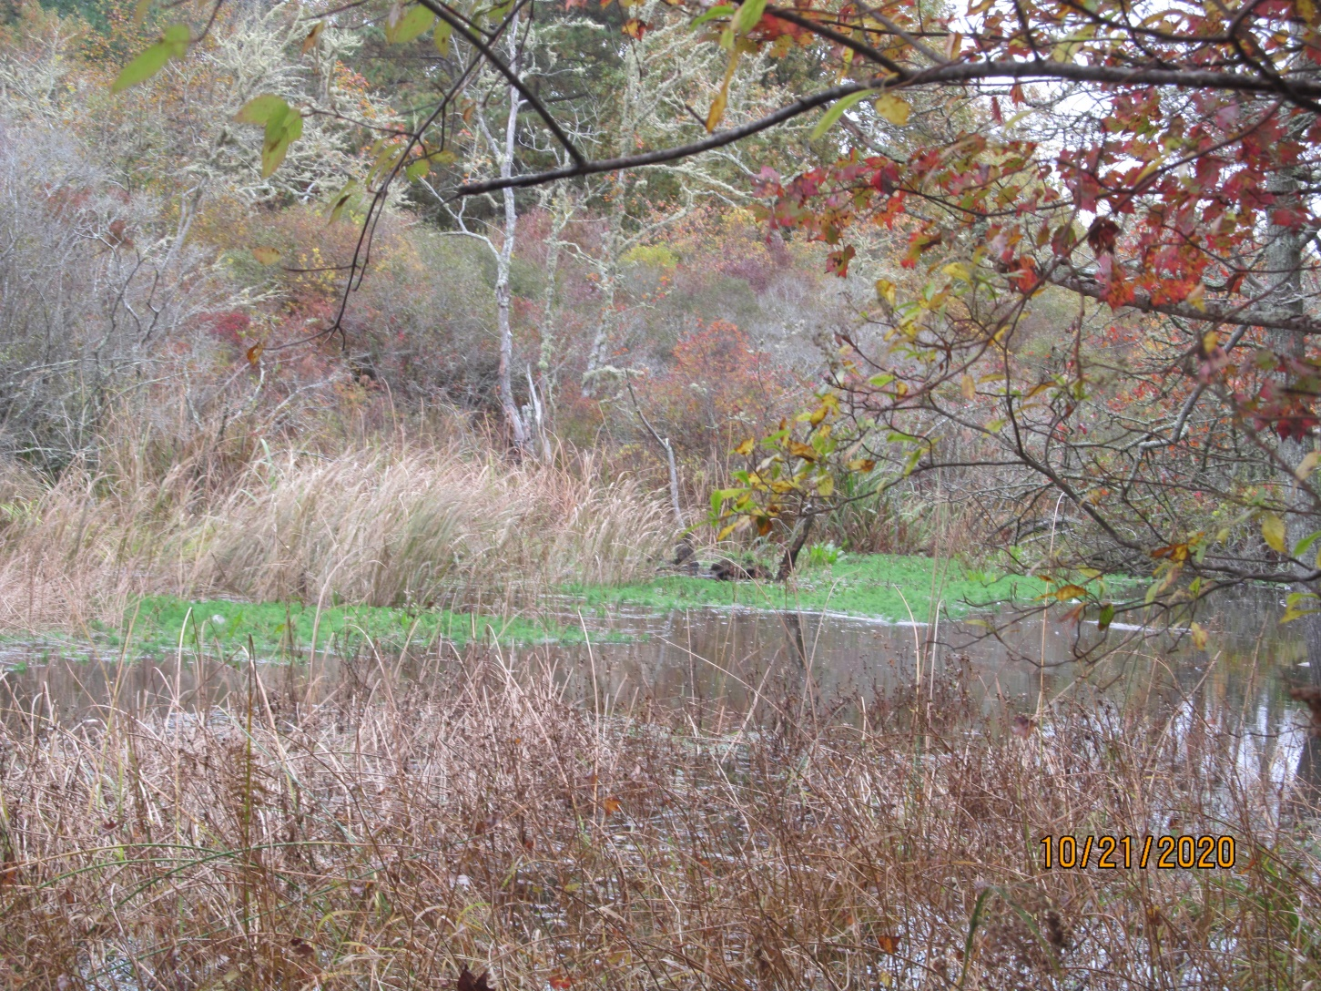

Slide 3
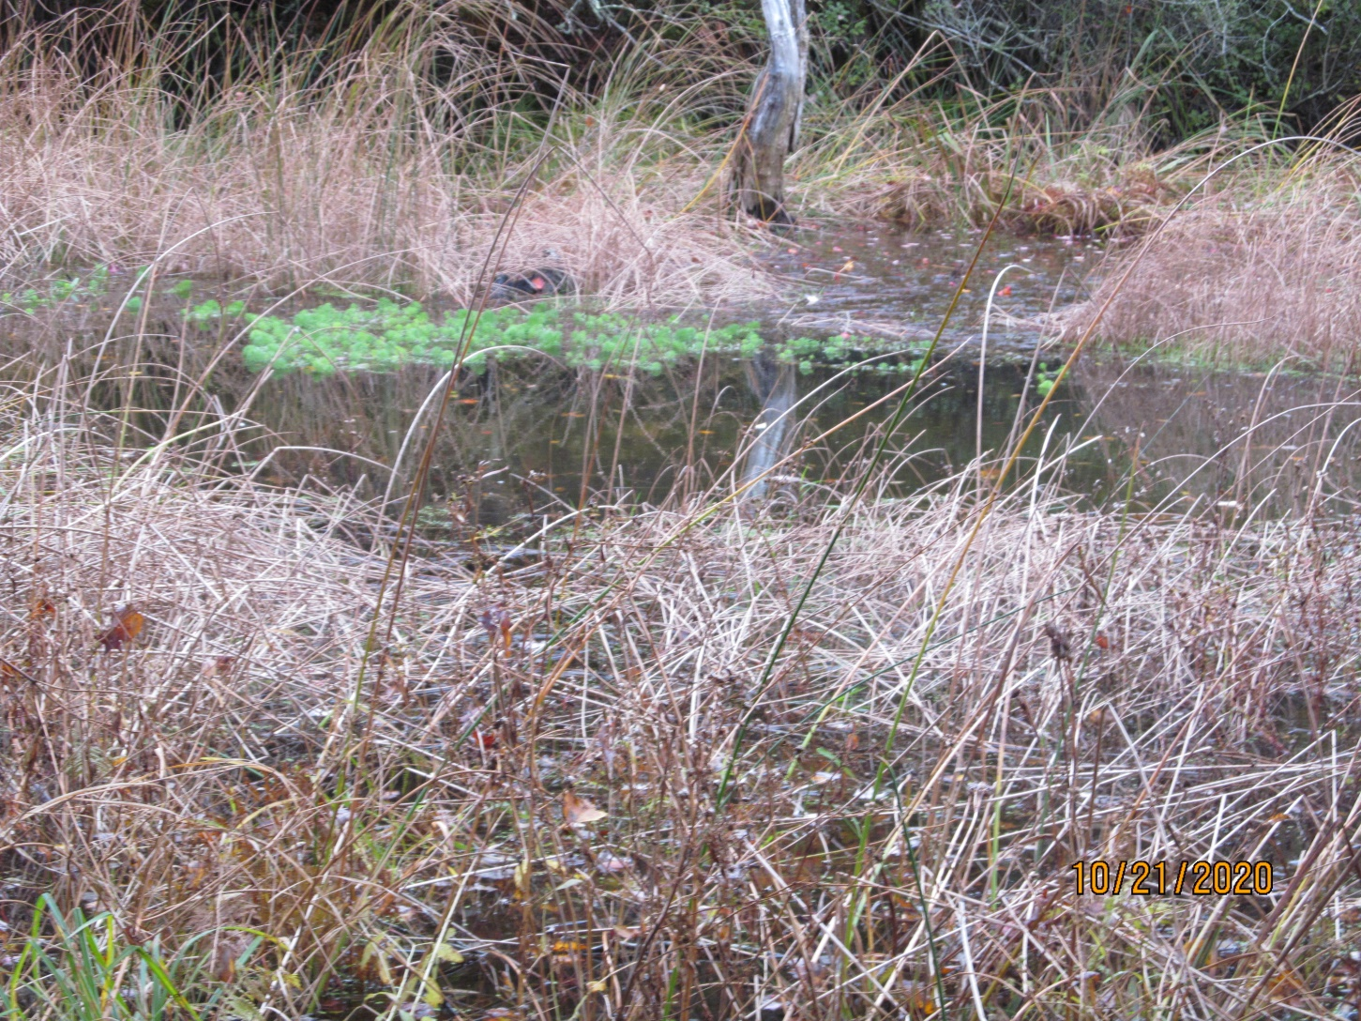

Slide 4
