Slide 1
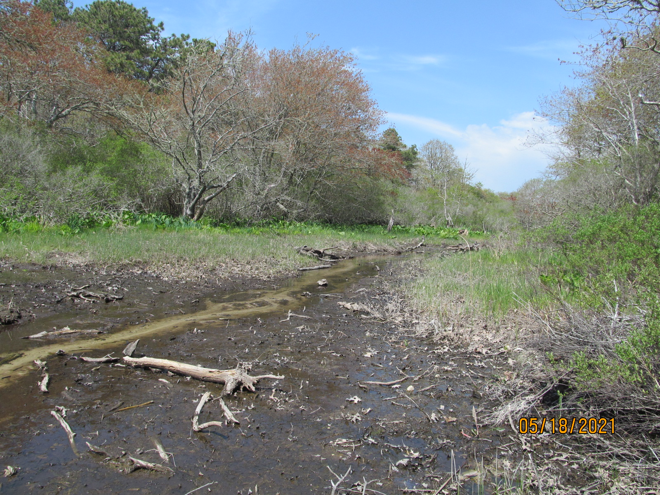
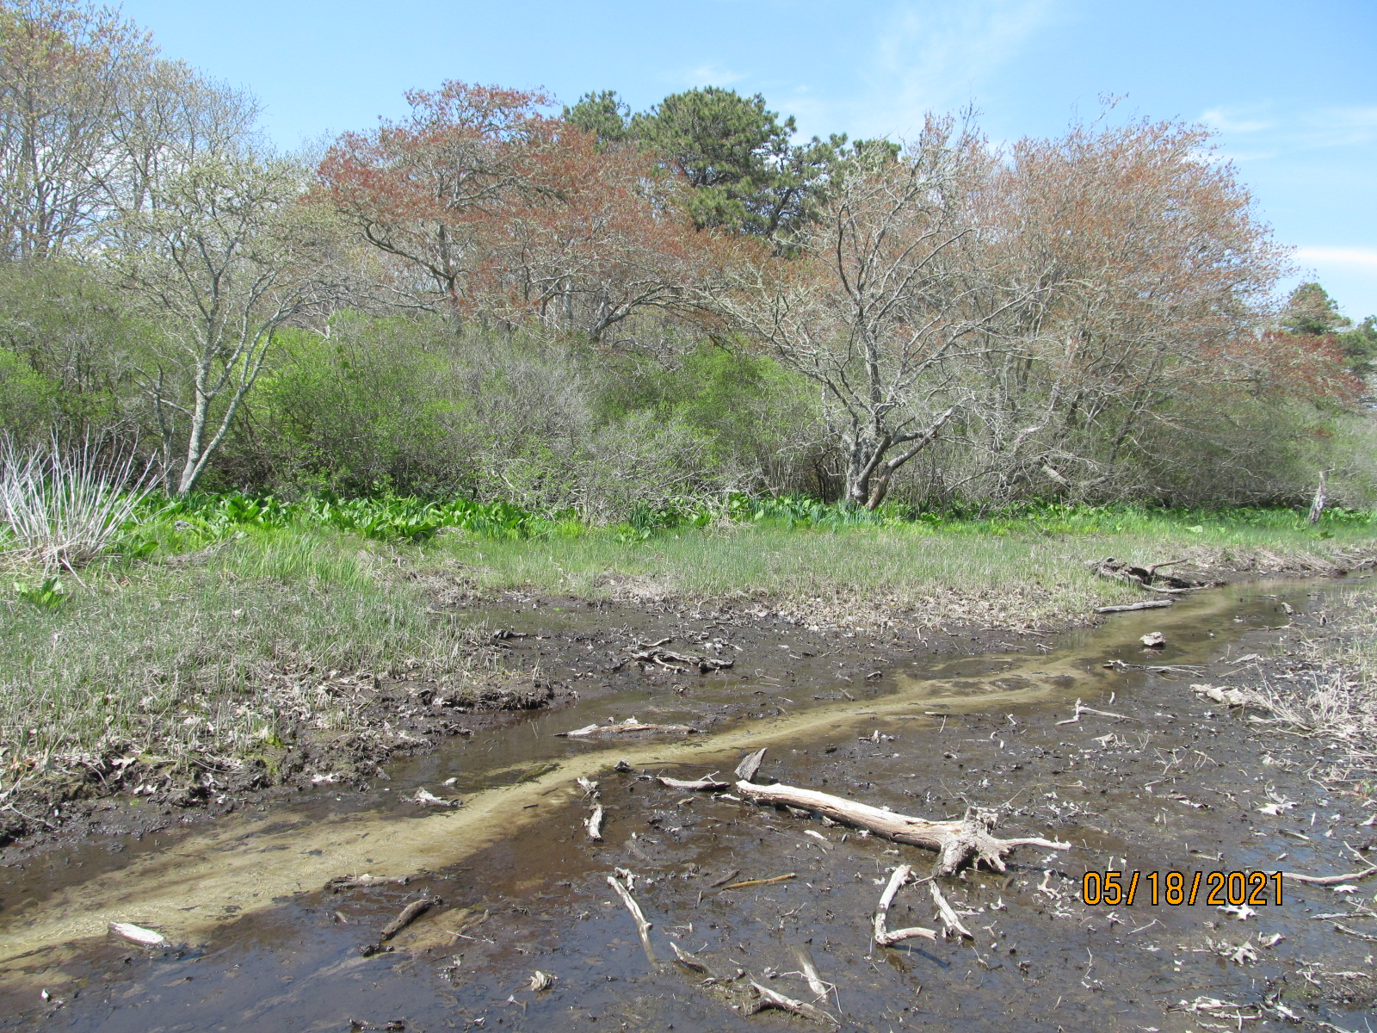
Site Visit
May 18, 2021
Pear Tree Cove
The dark green vegetation is not the Parrot Feather, but this is the location we saw it in last year.
Pond is open.

Slide 2
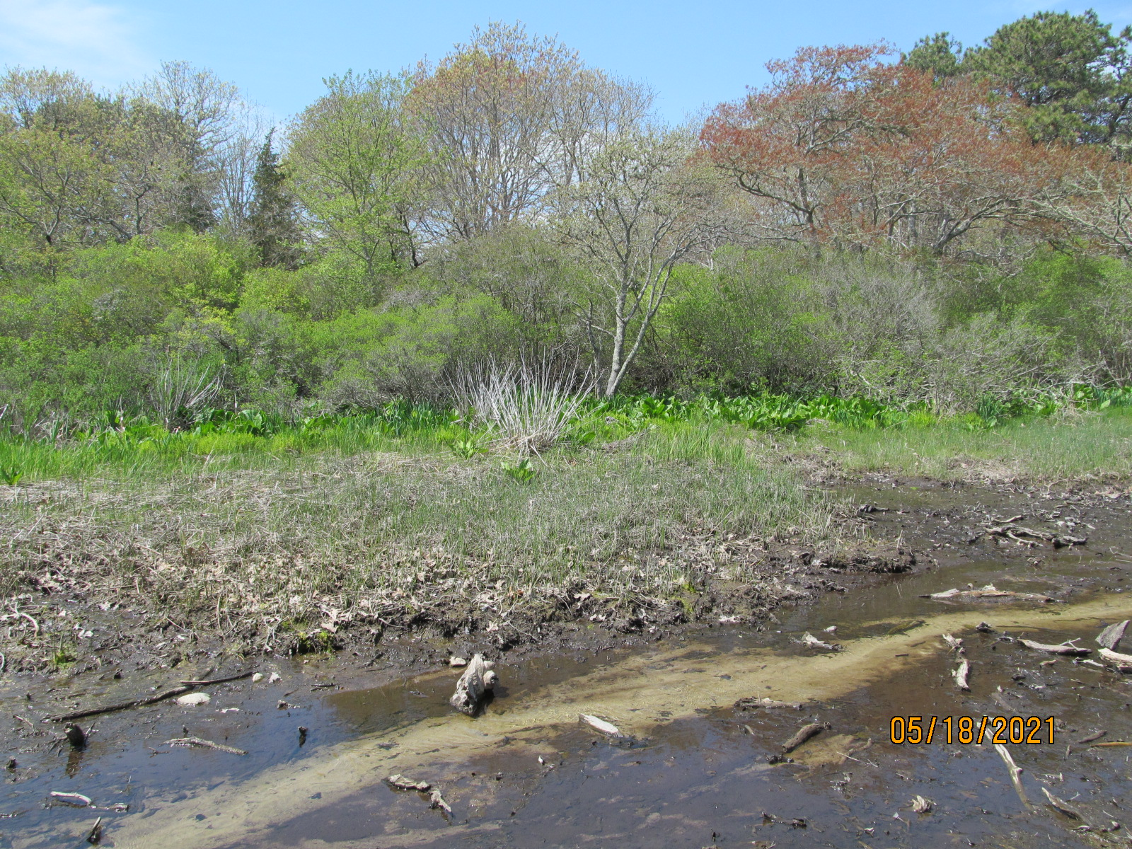
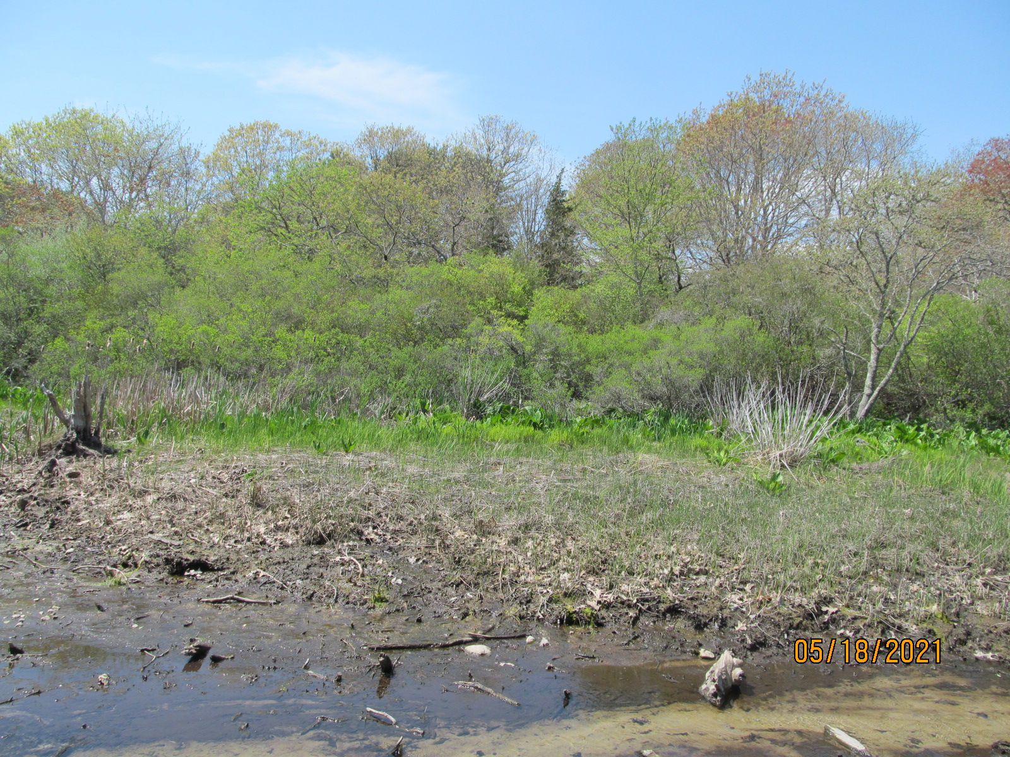
I’m not sure if the lighter, brighter green is the Parrot Feather.

Slide 3
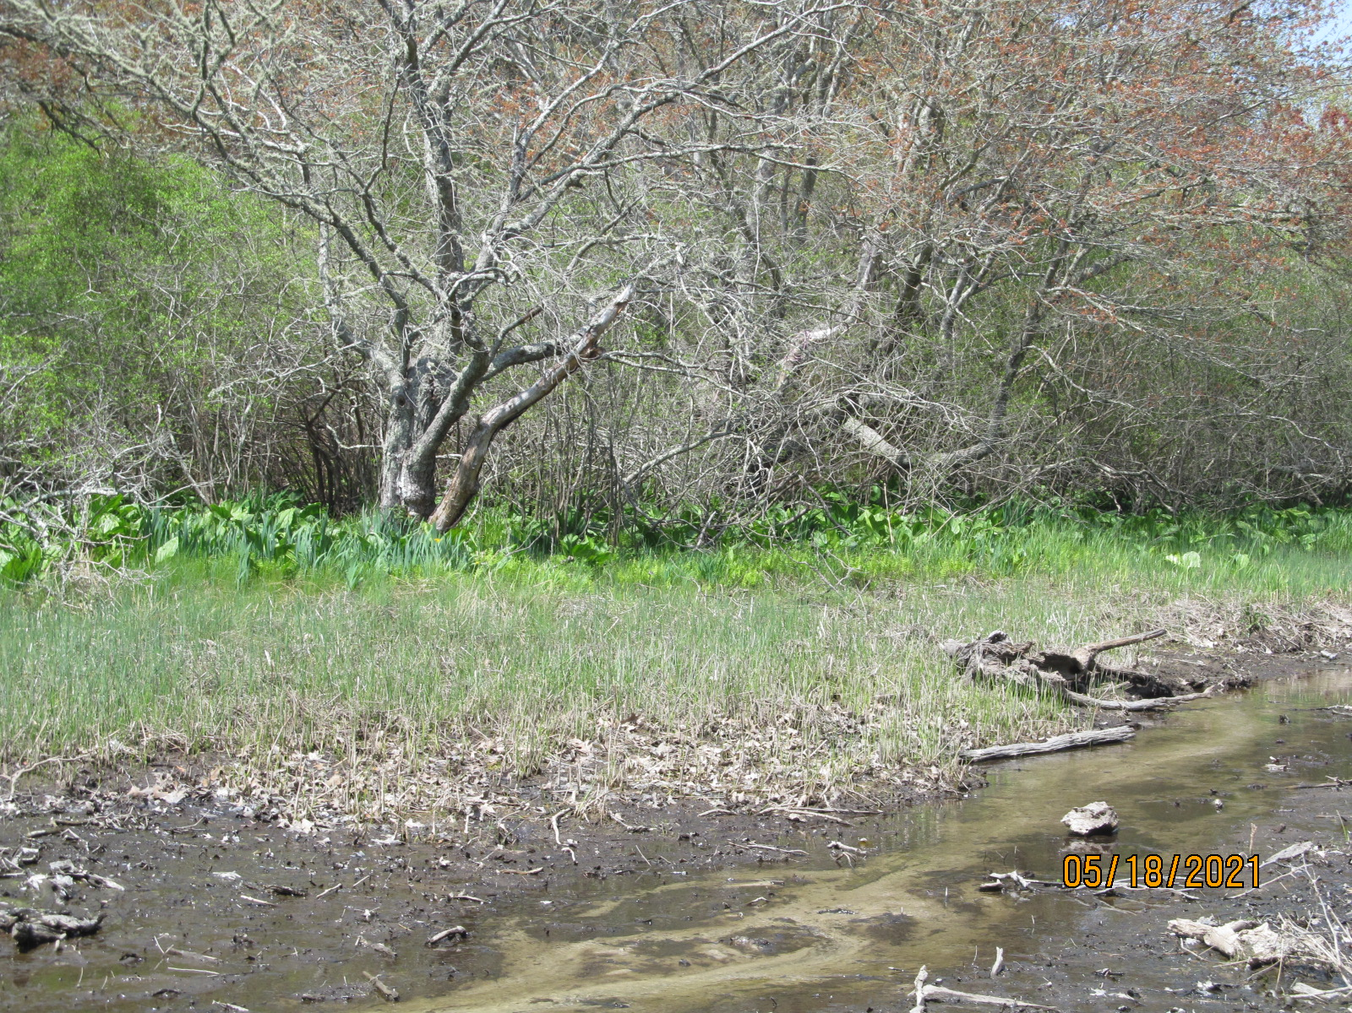
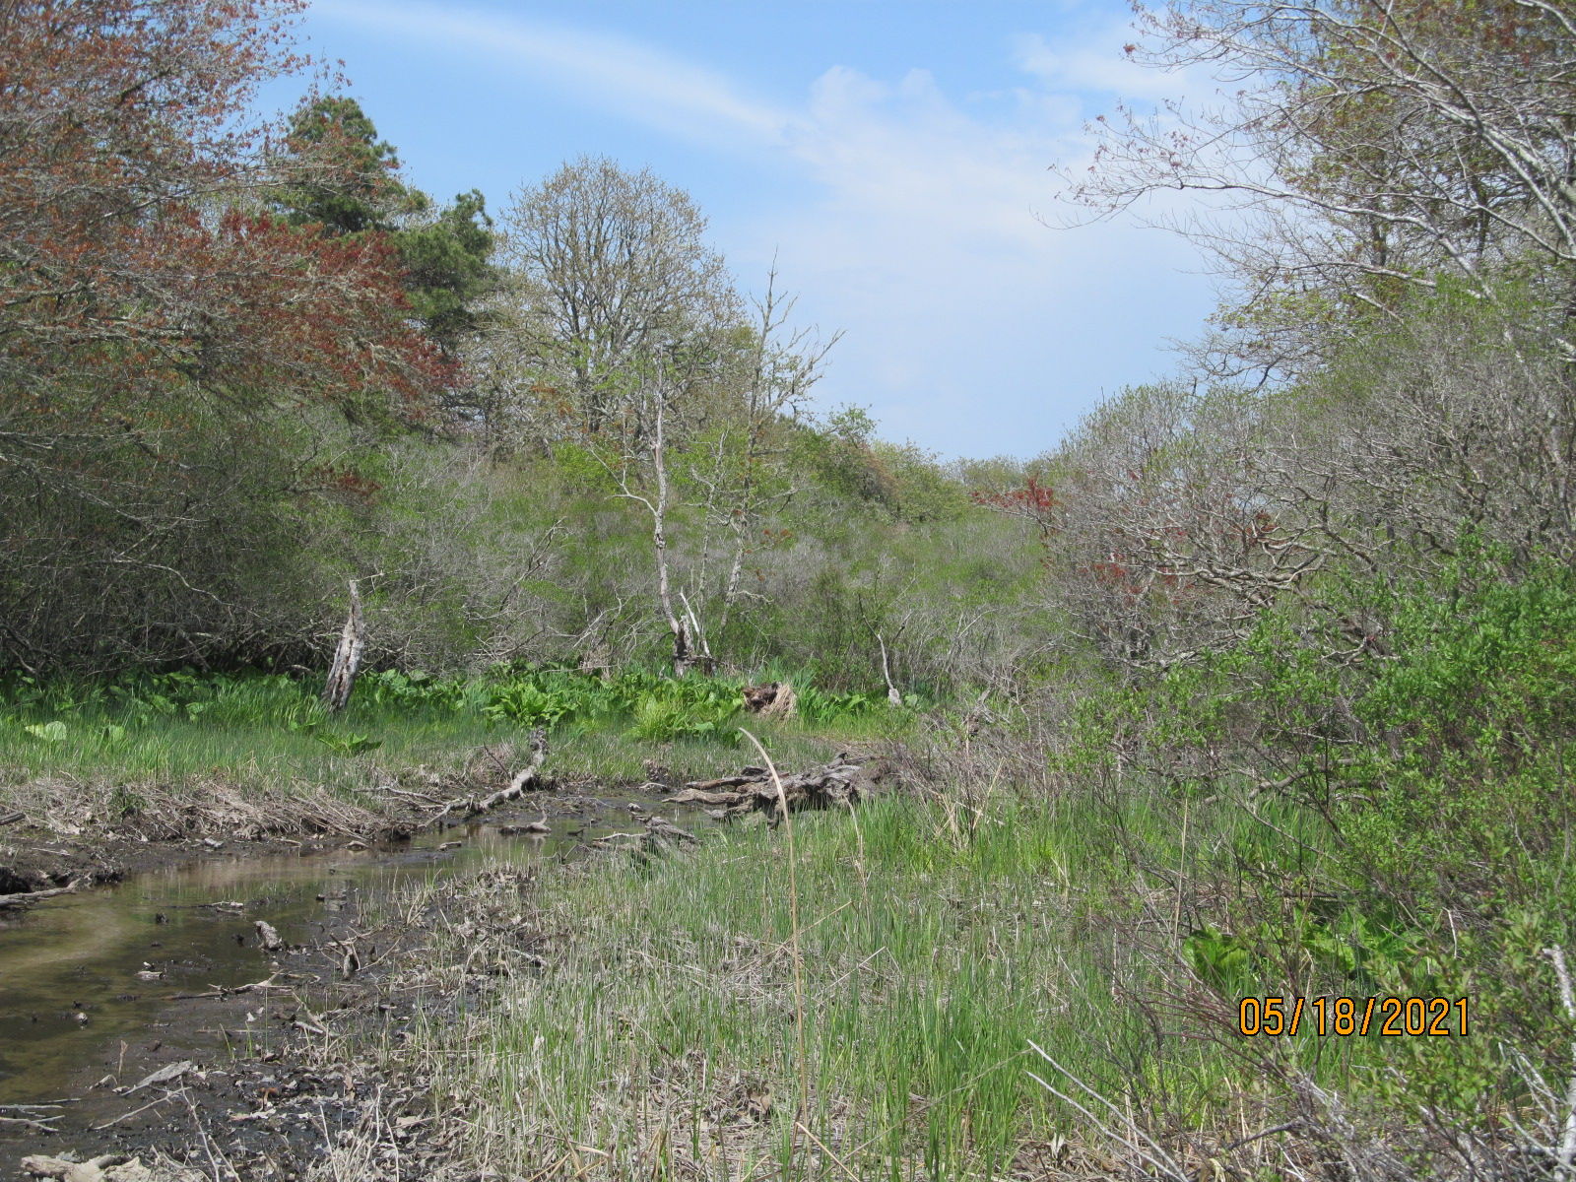

Slide 4
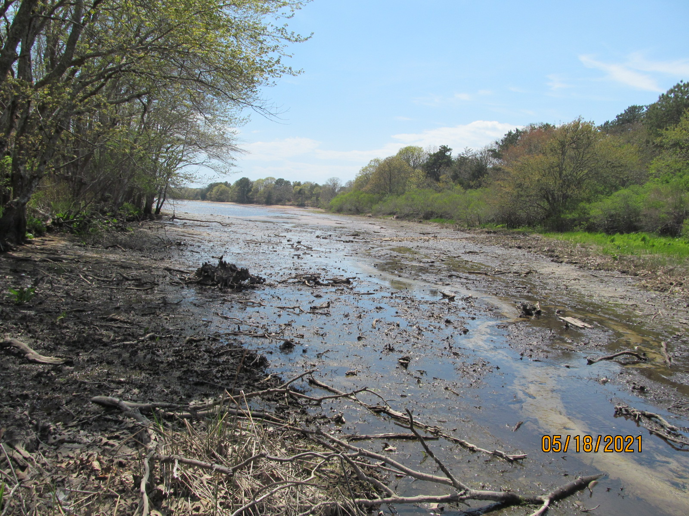
Pond is open

