Slide 1
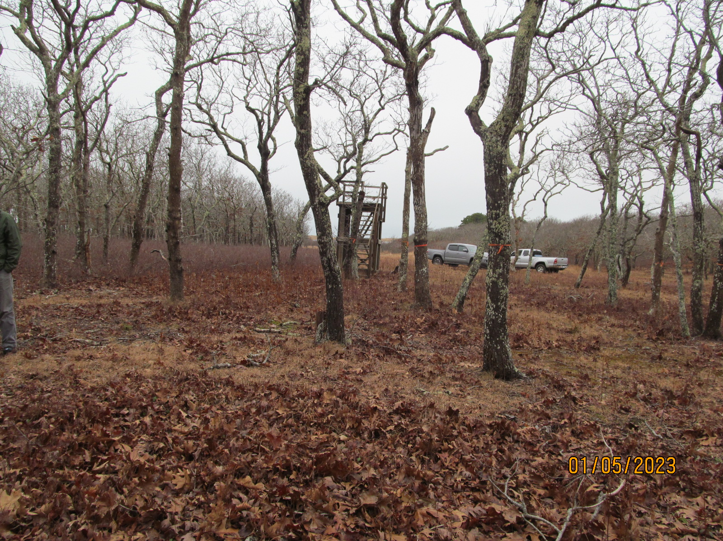
MAP 43 LOT 10
Site Visit
January 5, 2023

