Slide 1
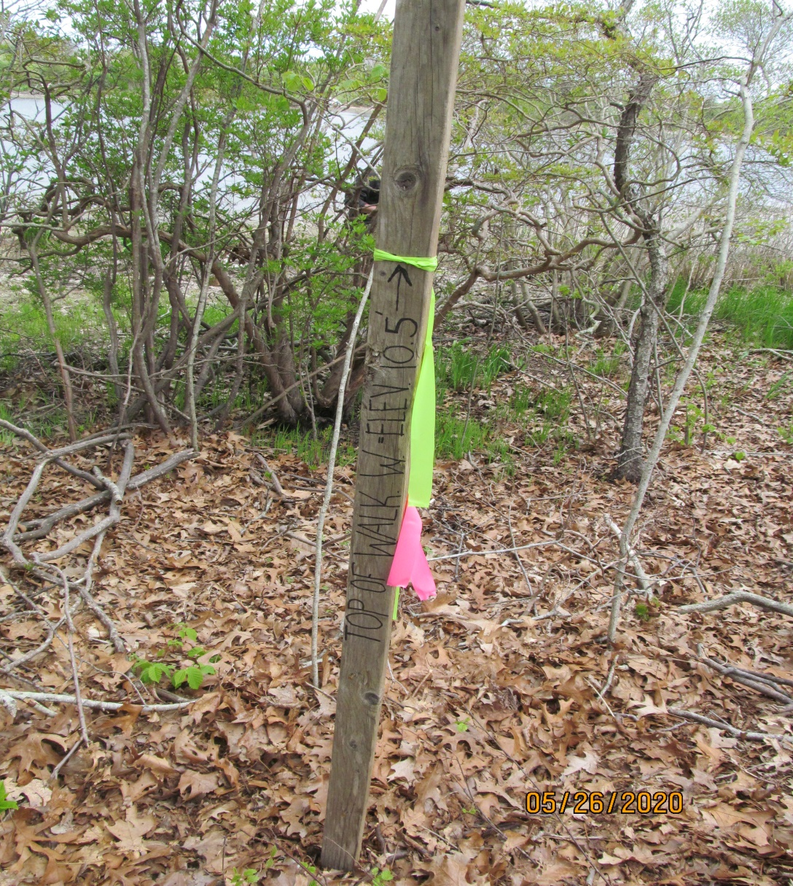
Site Visit
May 26, 2020
Map 35 Lot 7

Slide 2
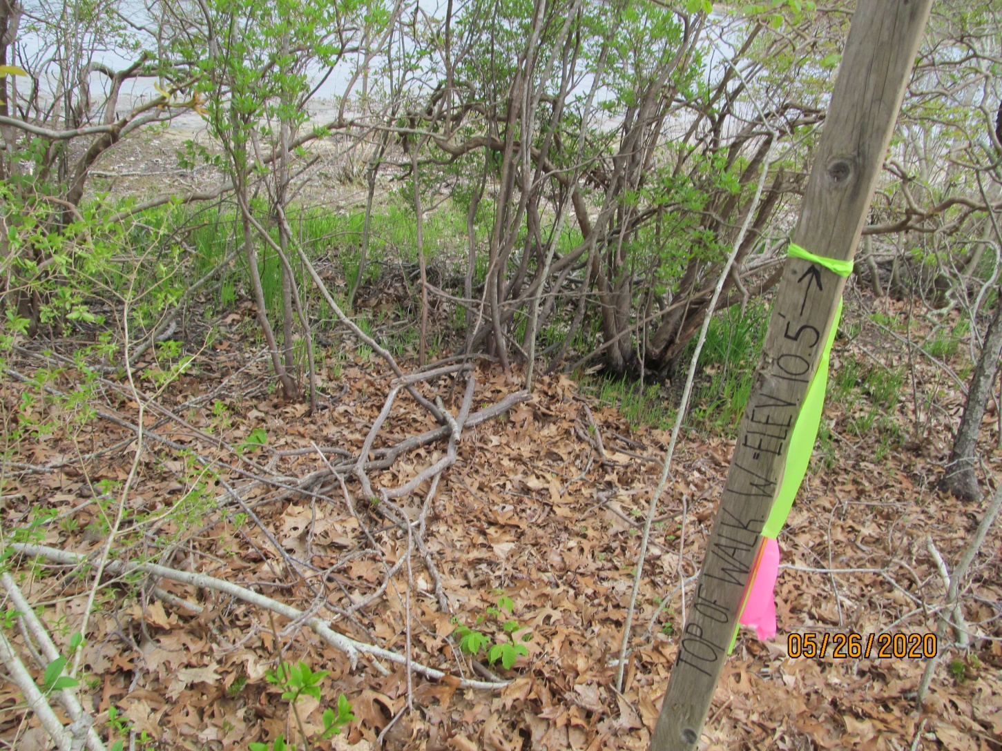

Slide 3
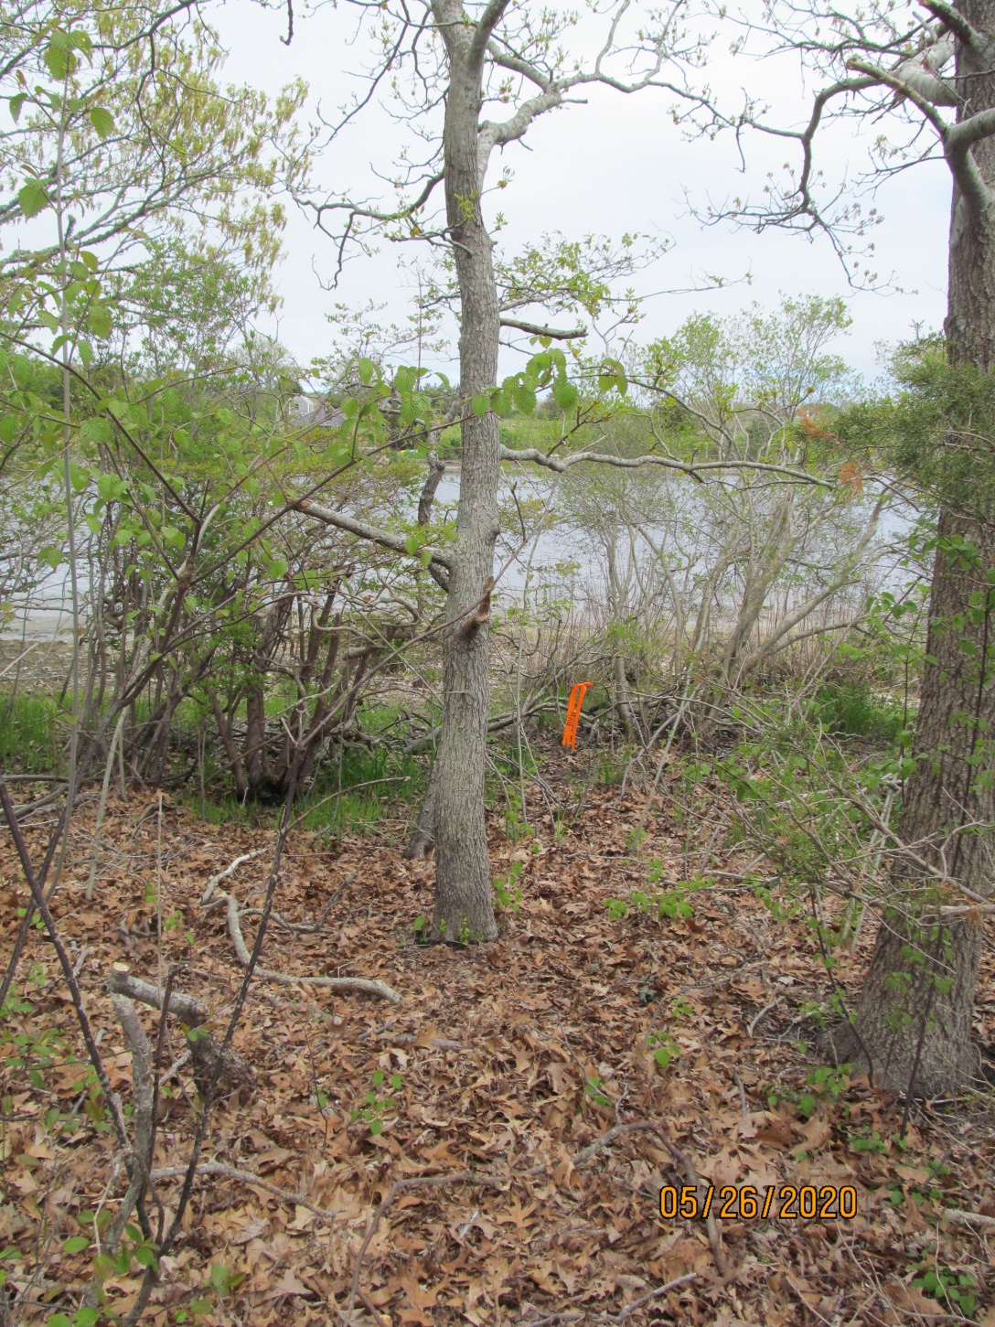

Slide 4
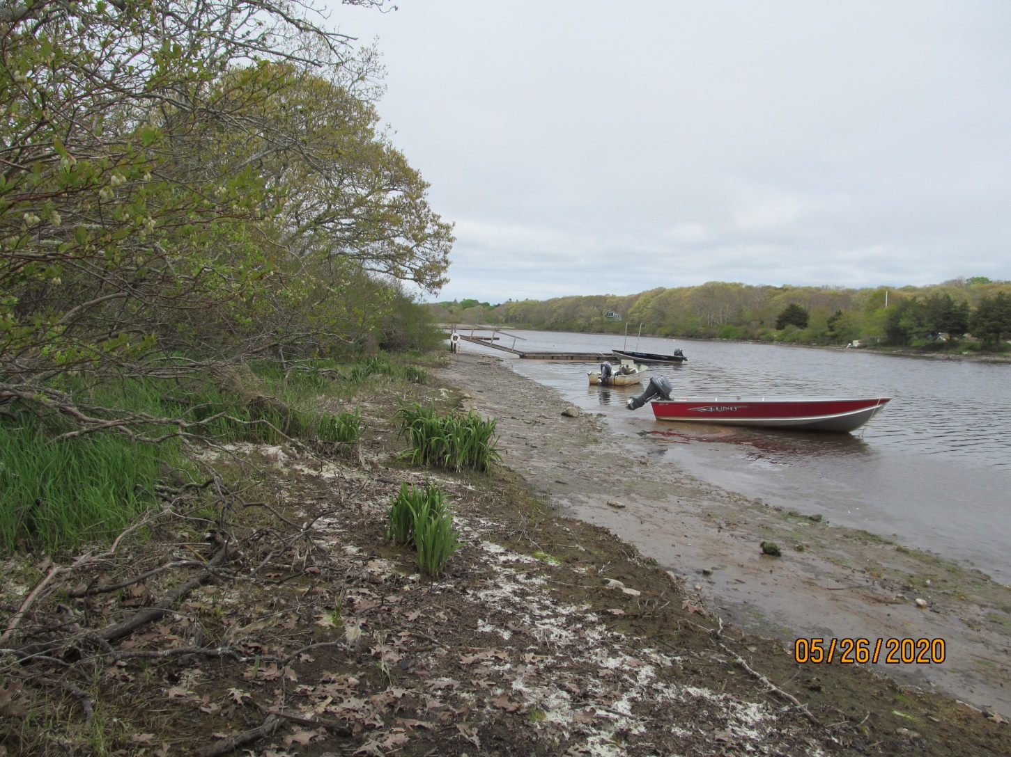

Slide 5
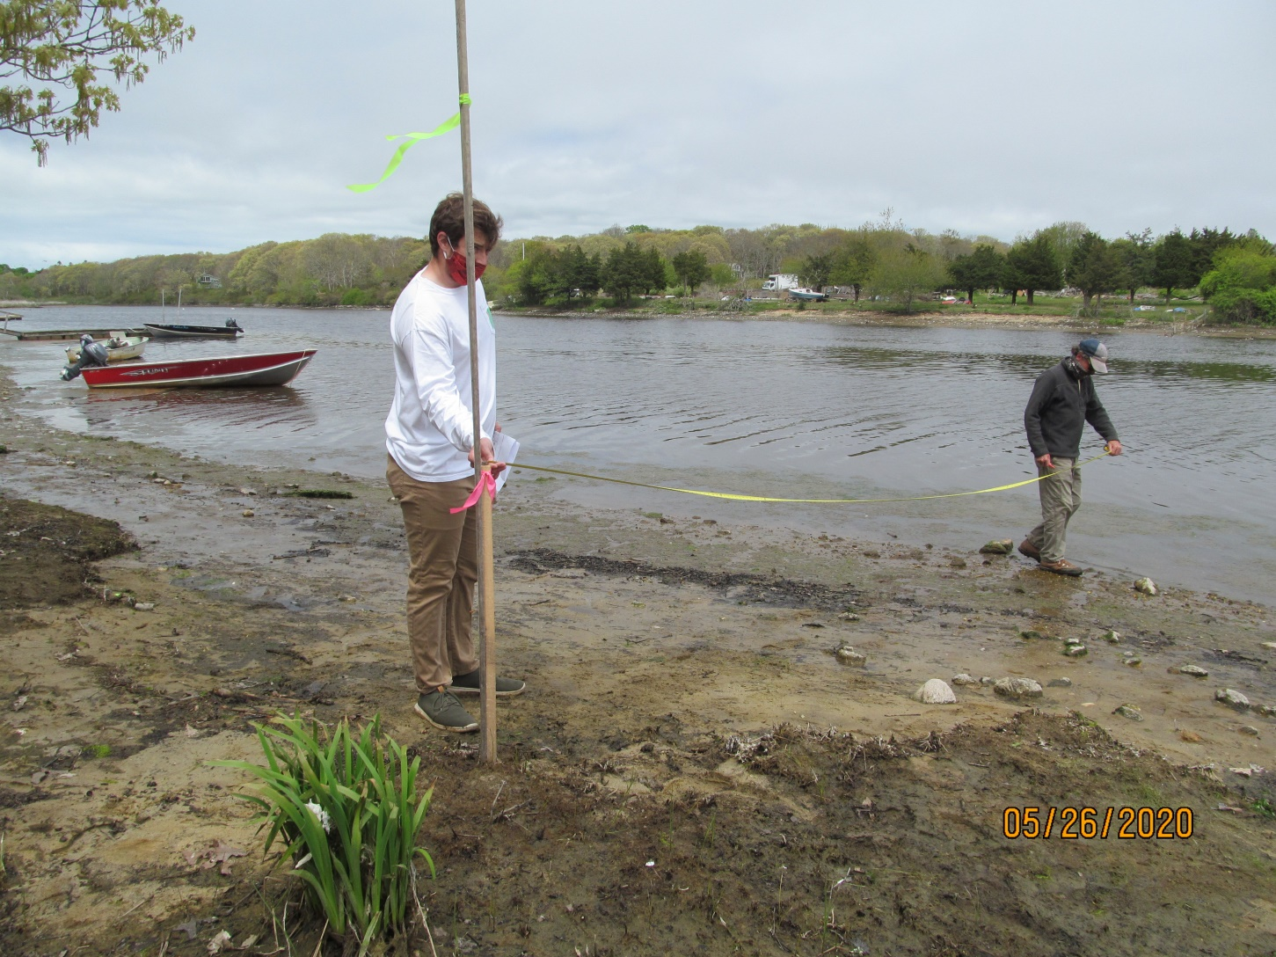

Slide 6
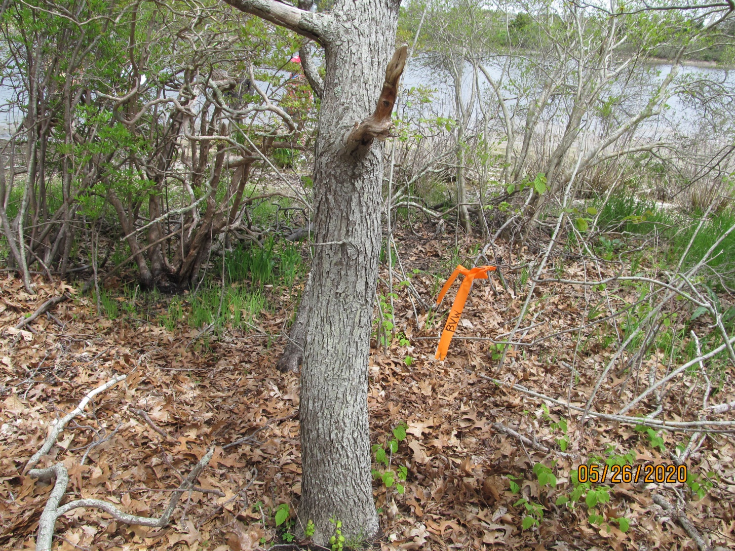

Slide 7
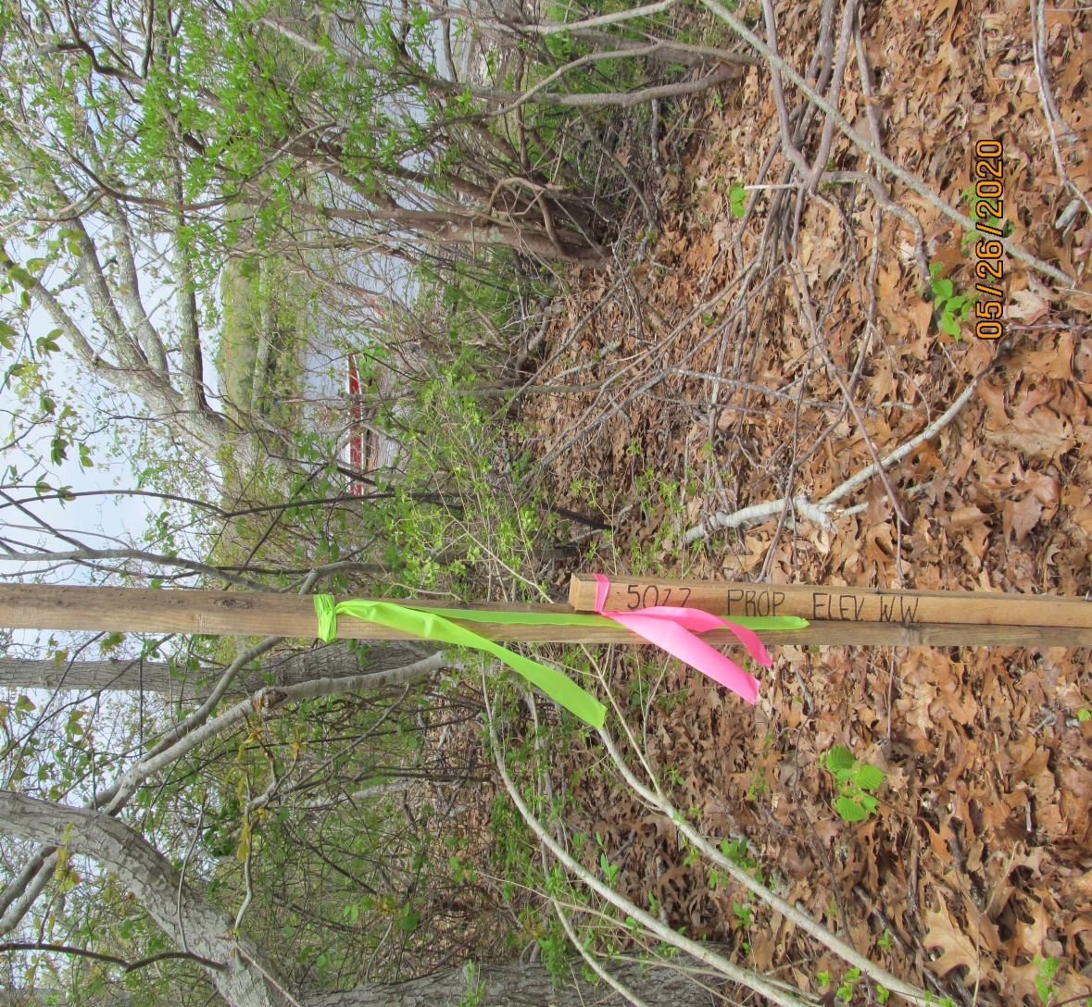

Slide 8
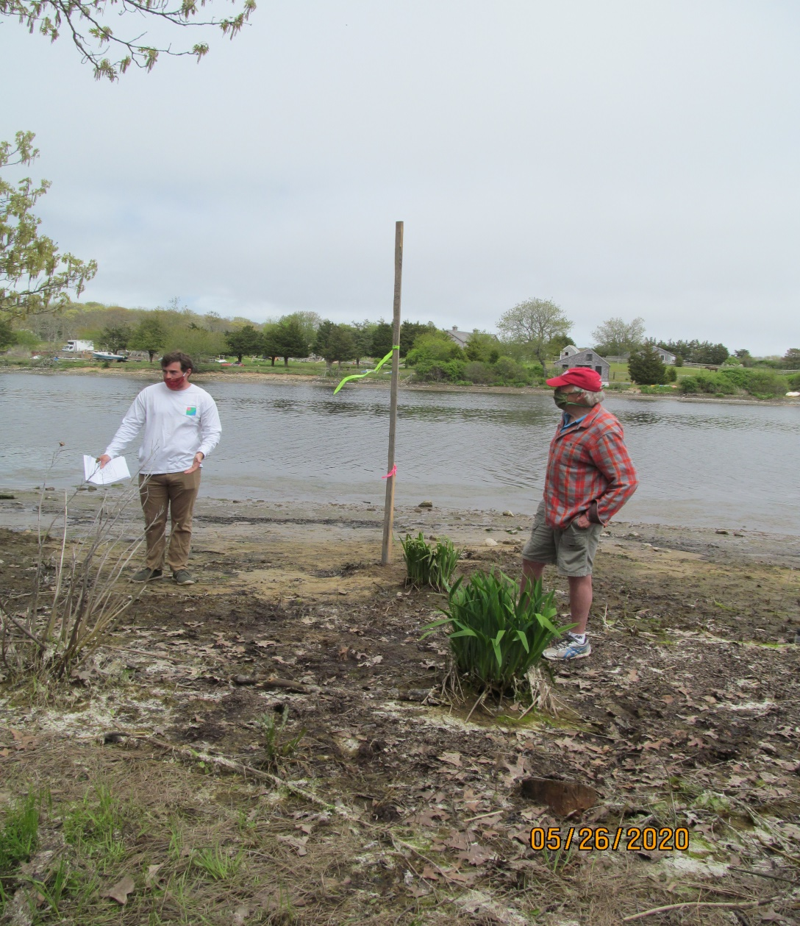

Slide 9
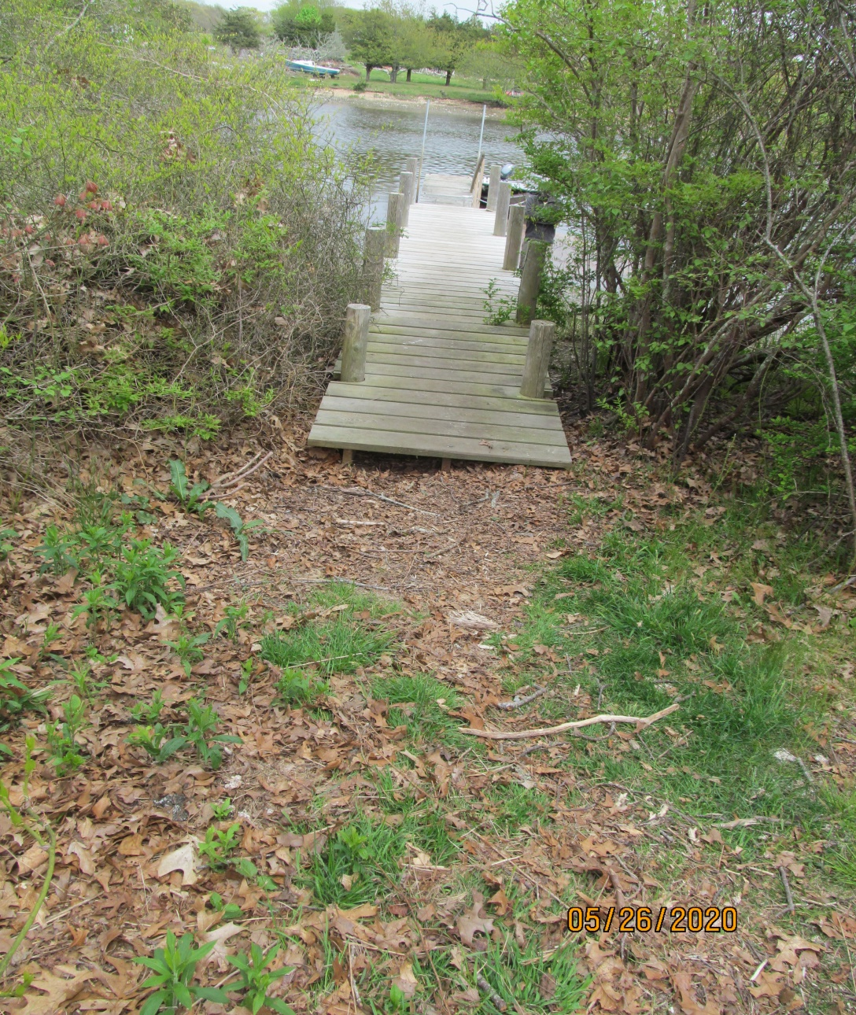
Hearn Dock
Constructed in 2006.
See copy of photos showing flooded boardwalk at high pond.

Slide 10
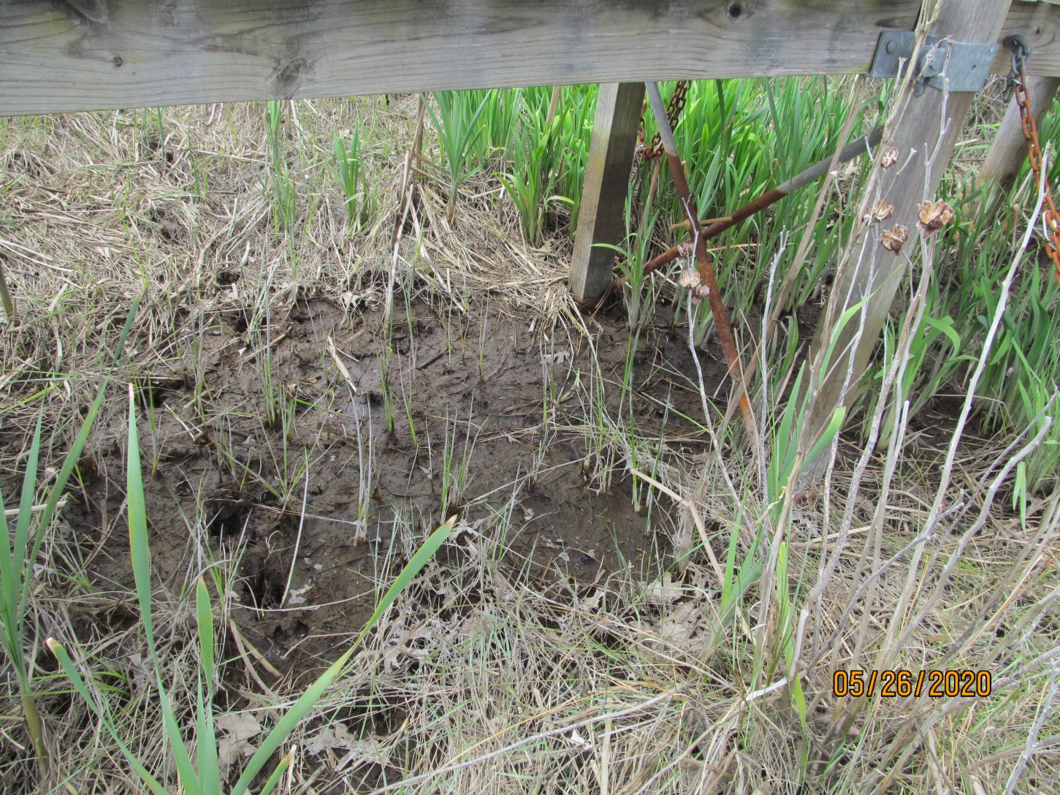
Under the Thomas Dock at Map 34 Lot 10 vegetation adjacent to boardwalk and mud underneath.

Slide 11
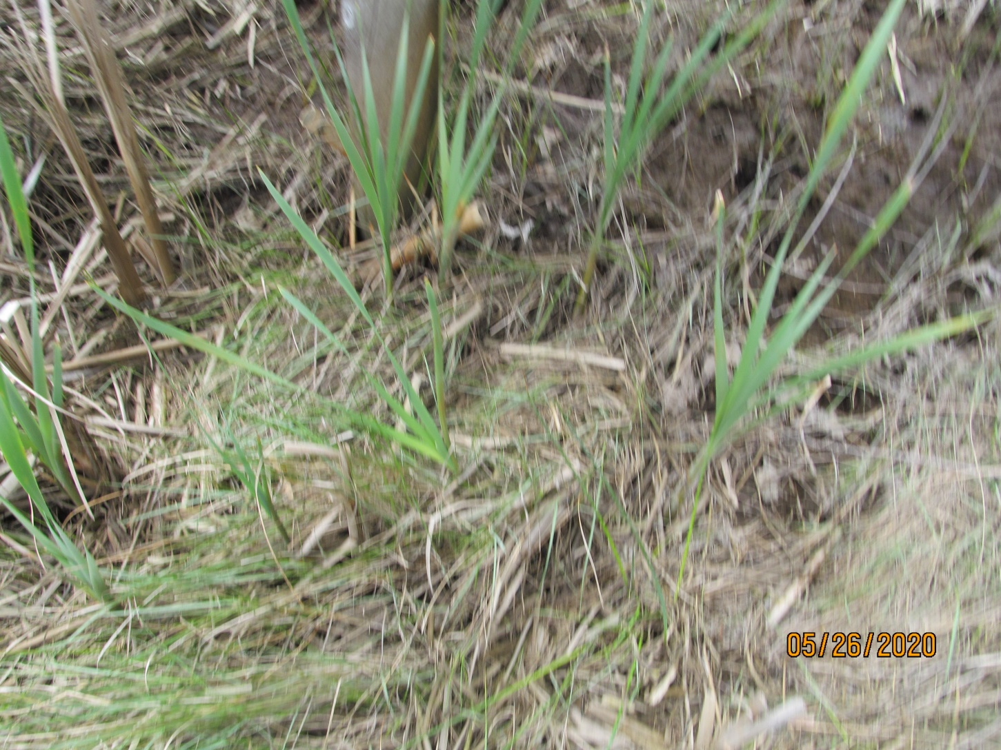

Slide 12
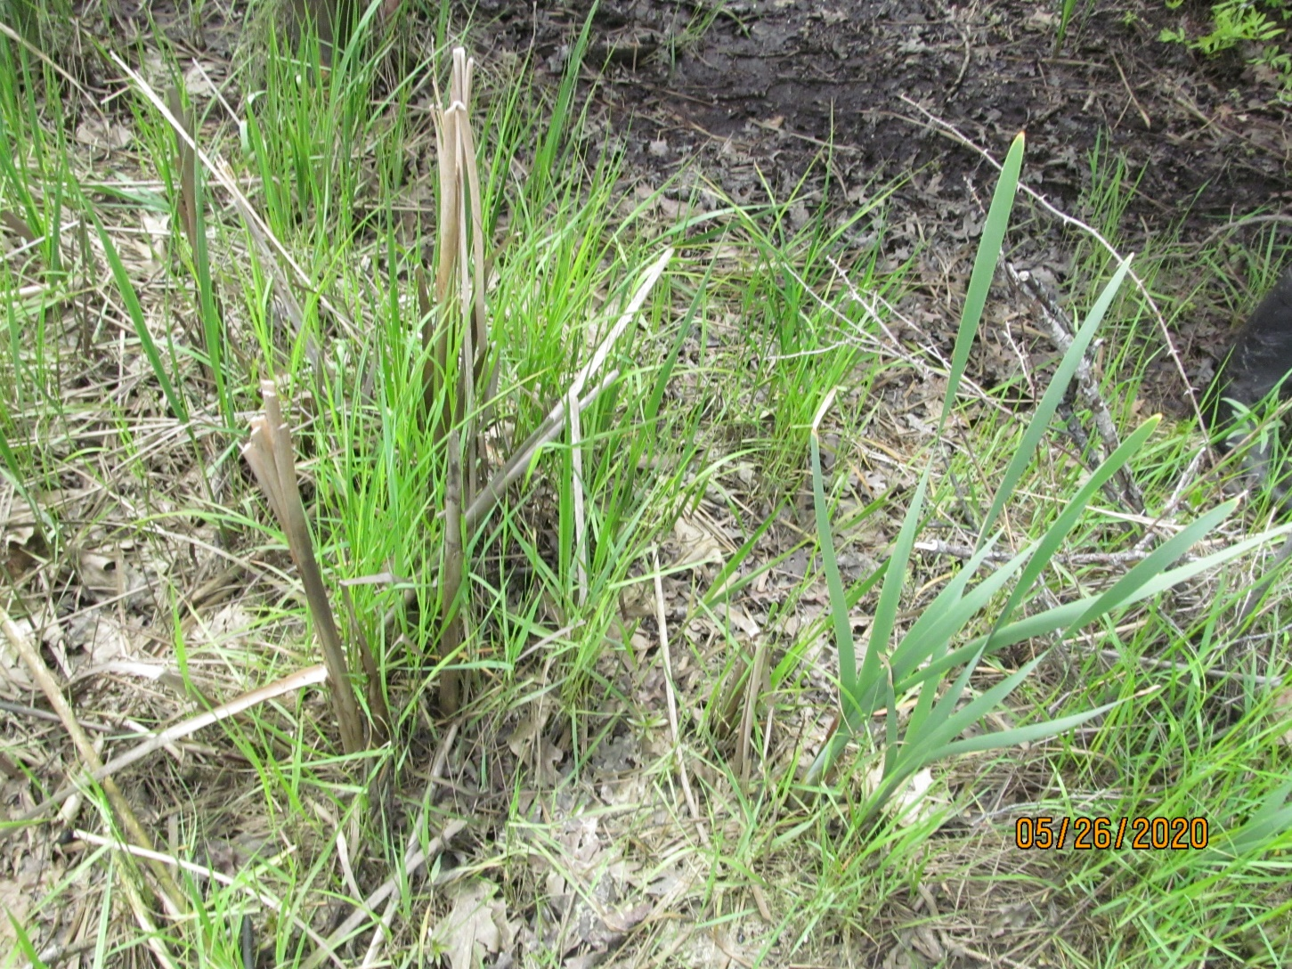
Vegetation next to Thomas dock. Mud under the dock.

Slide 14
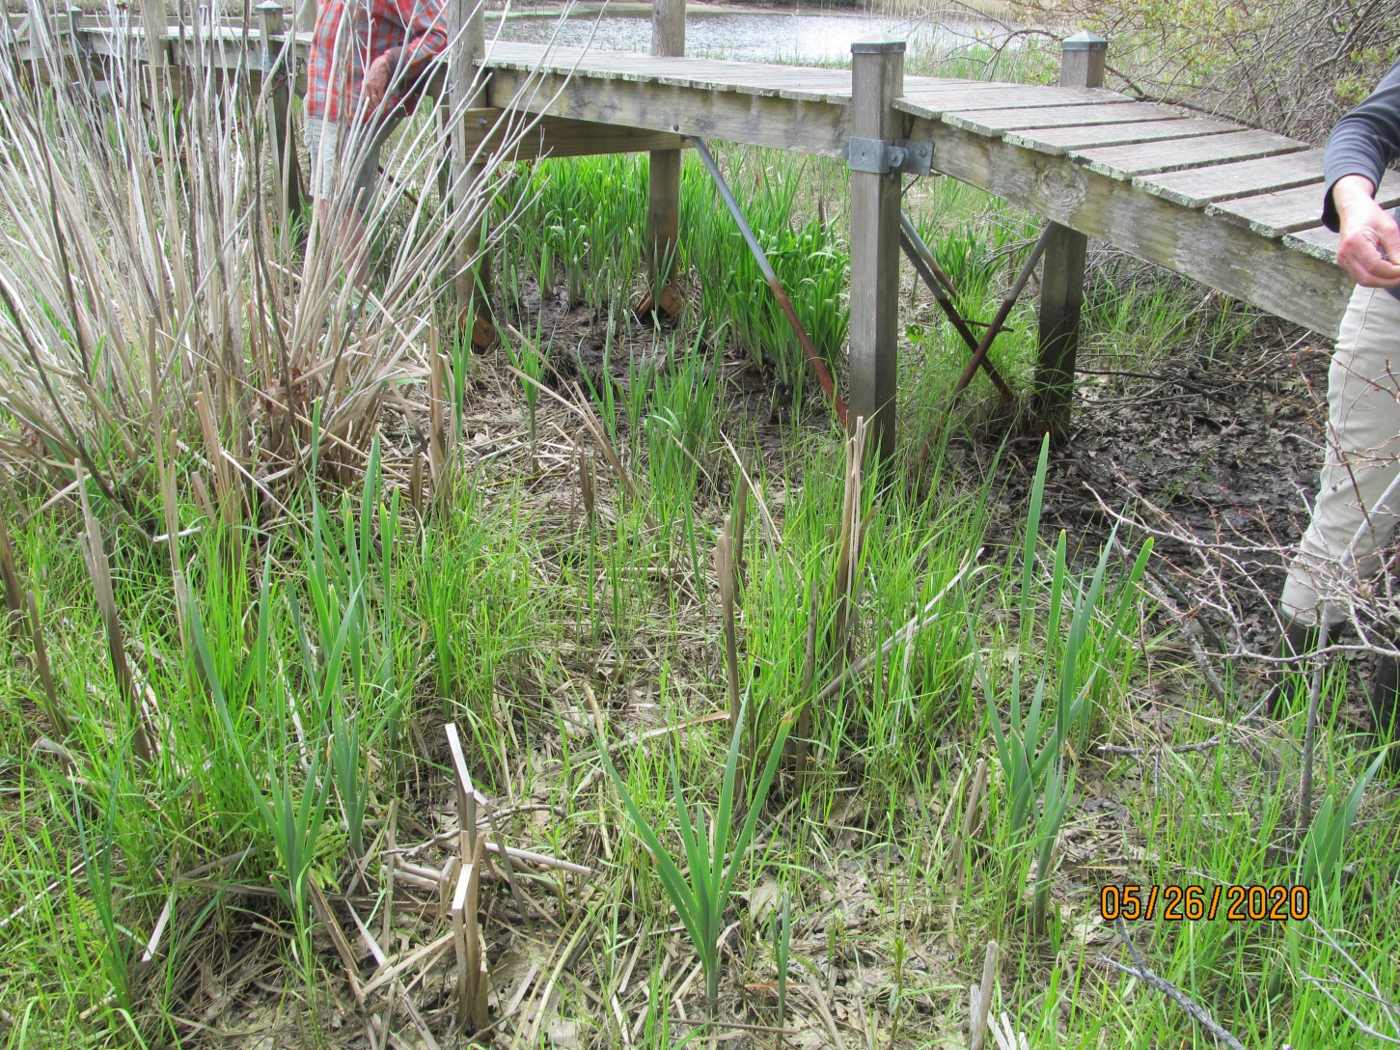
Thomas Dock at Map 34 Lot 10

