Slide 1
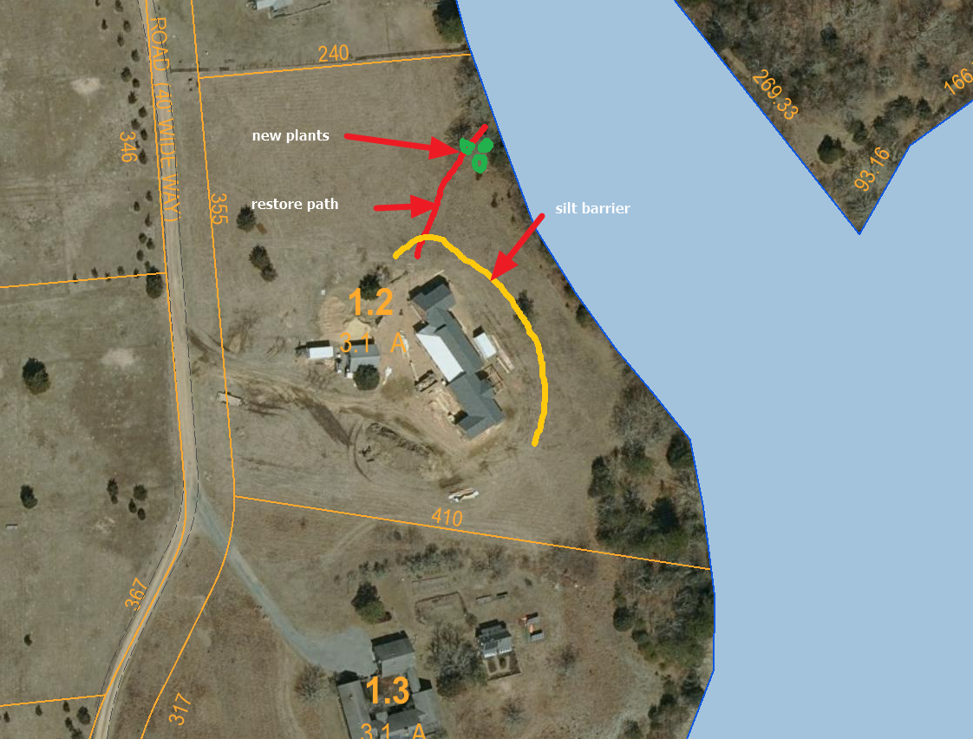
MAP 35 LOT 1.2
SKETCHES FROM GARDEN ANGELS
EROSION CONTROLS AND
LOCATION OF 9 NATIVE SHRUBS TO BE PLANTED

Slide 2
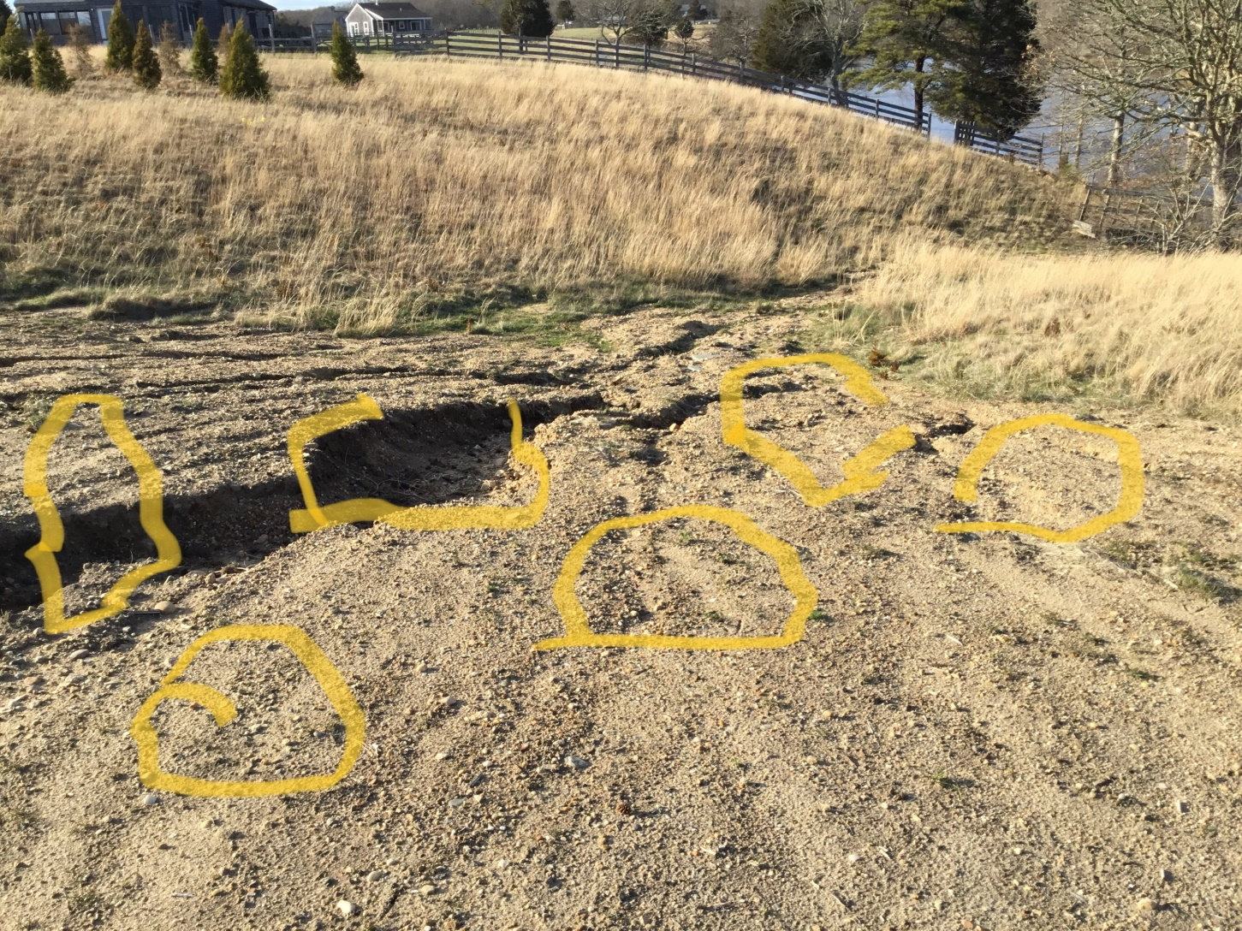

Slide 3
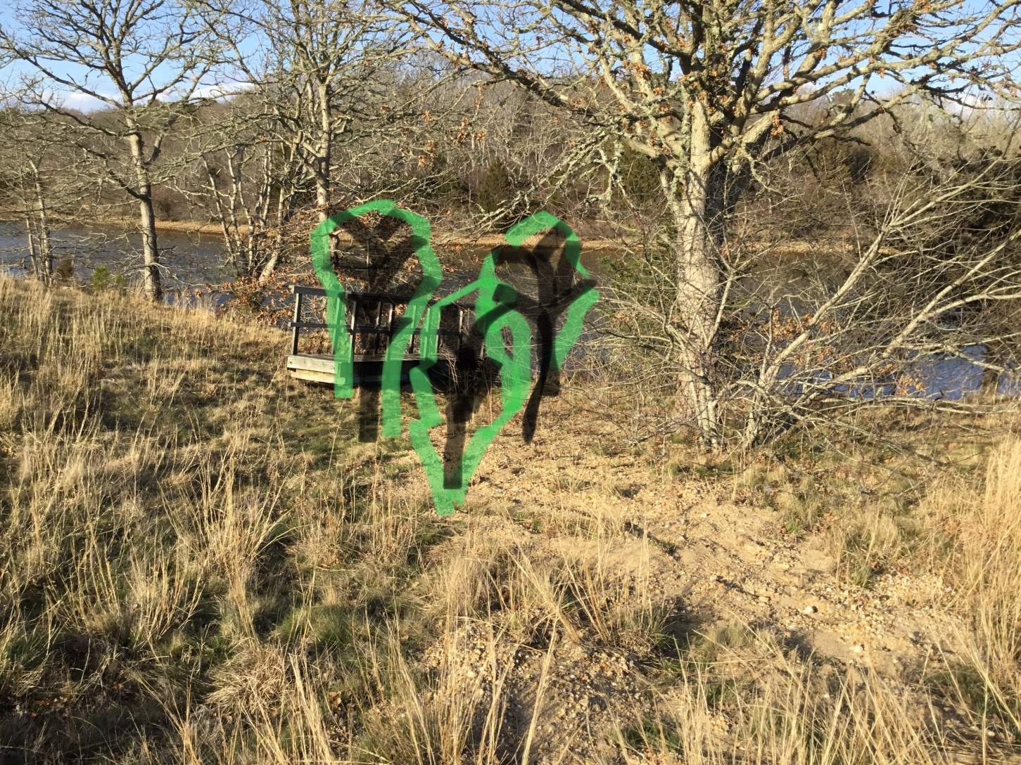

Slide 4
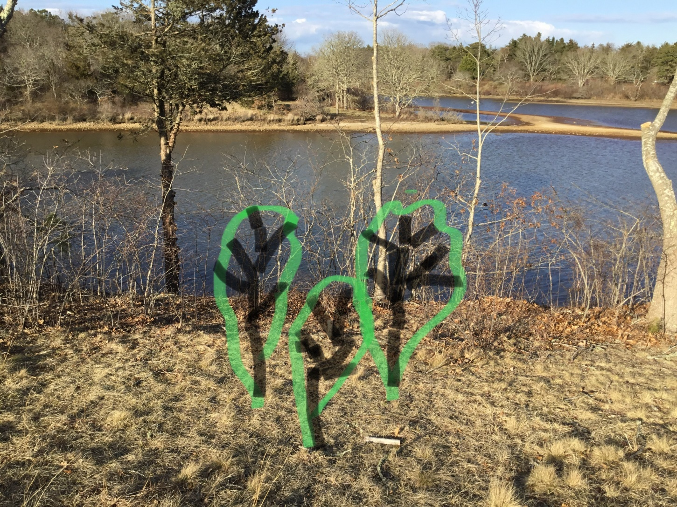

Slide 5
