Slide 1
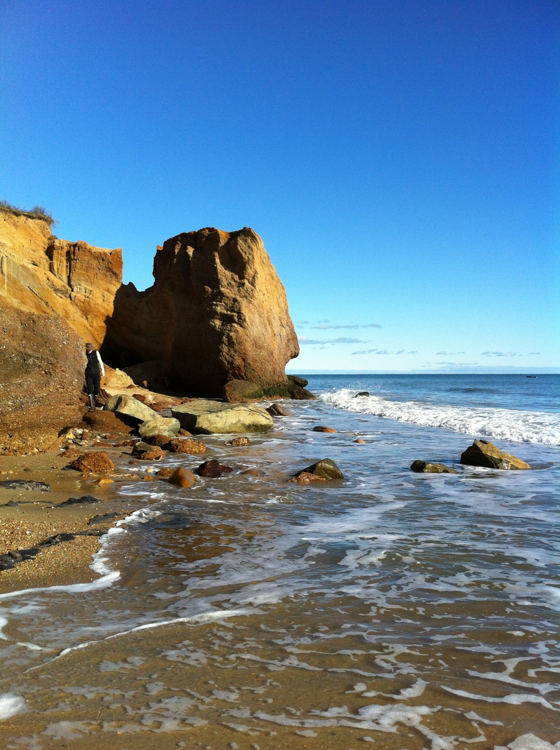
Getting to 100% Renewable Building a Clean Energy Future
Our SHARED RESPONSIBILITY

Slide 2
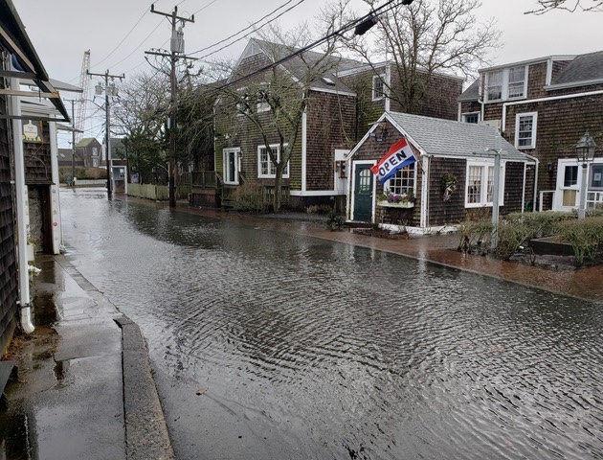
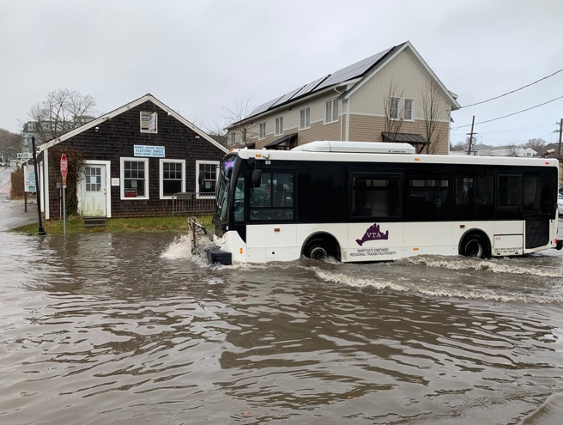
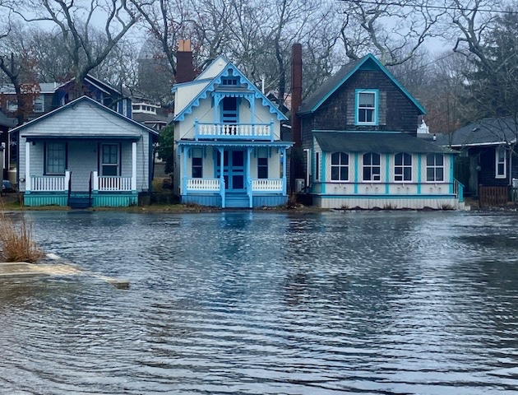
Climate change is happening at a rapid rate, much faster than was predicted.
For us, it can be seen so far by increased drought, stronger storm events with subsequent flooding, strong winds and rising temperatures.
Photos by Juliet Mulinare, Rich Saltzberg and liz Durkee

Slide 3
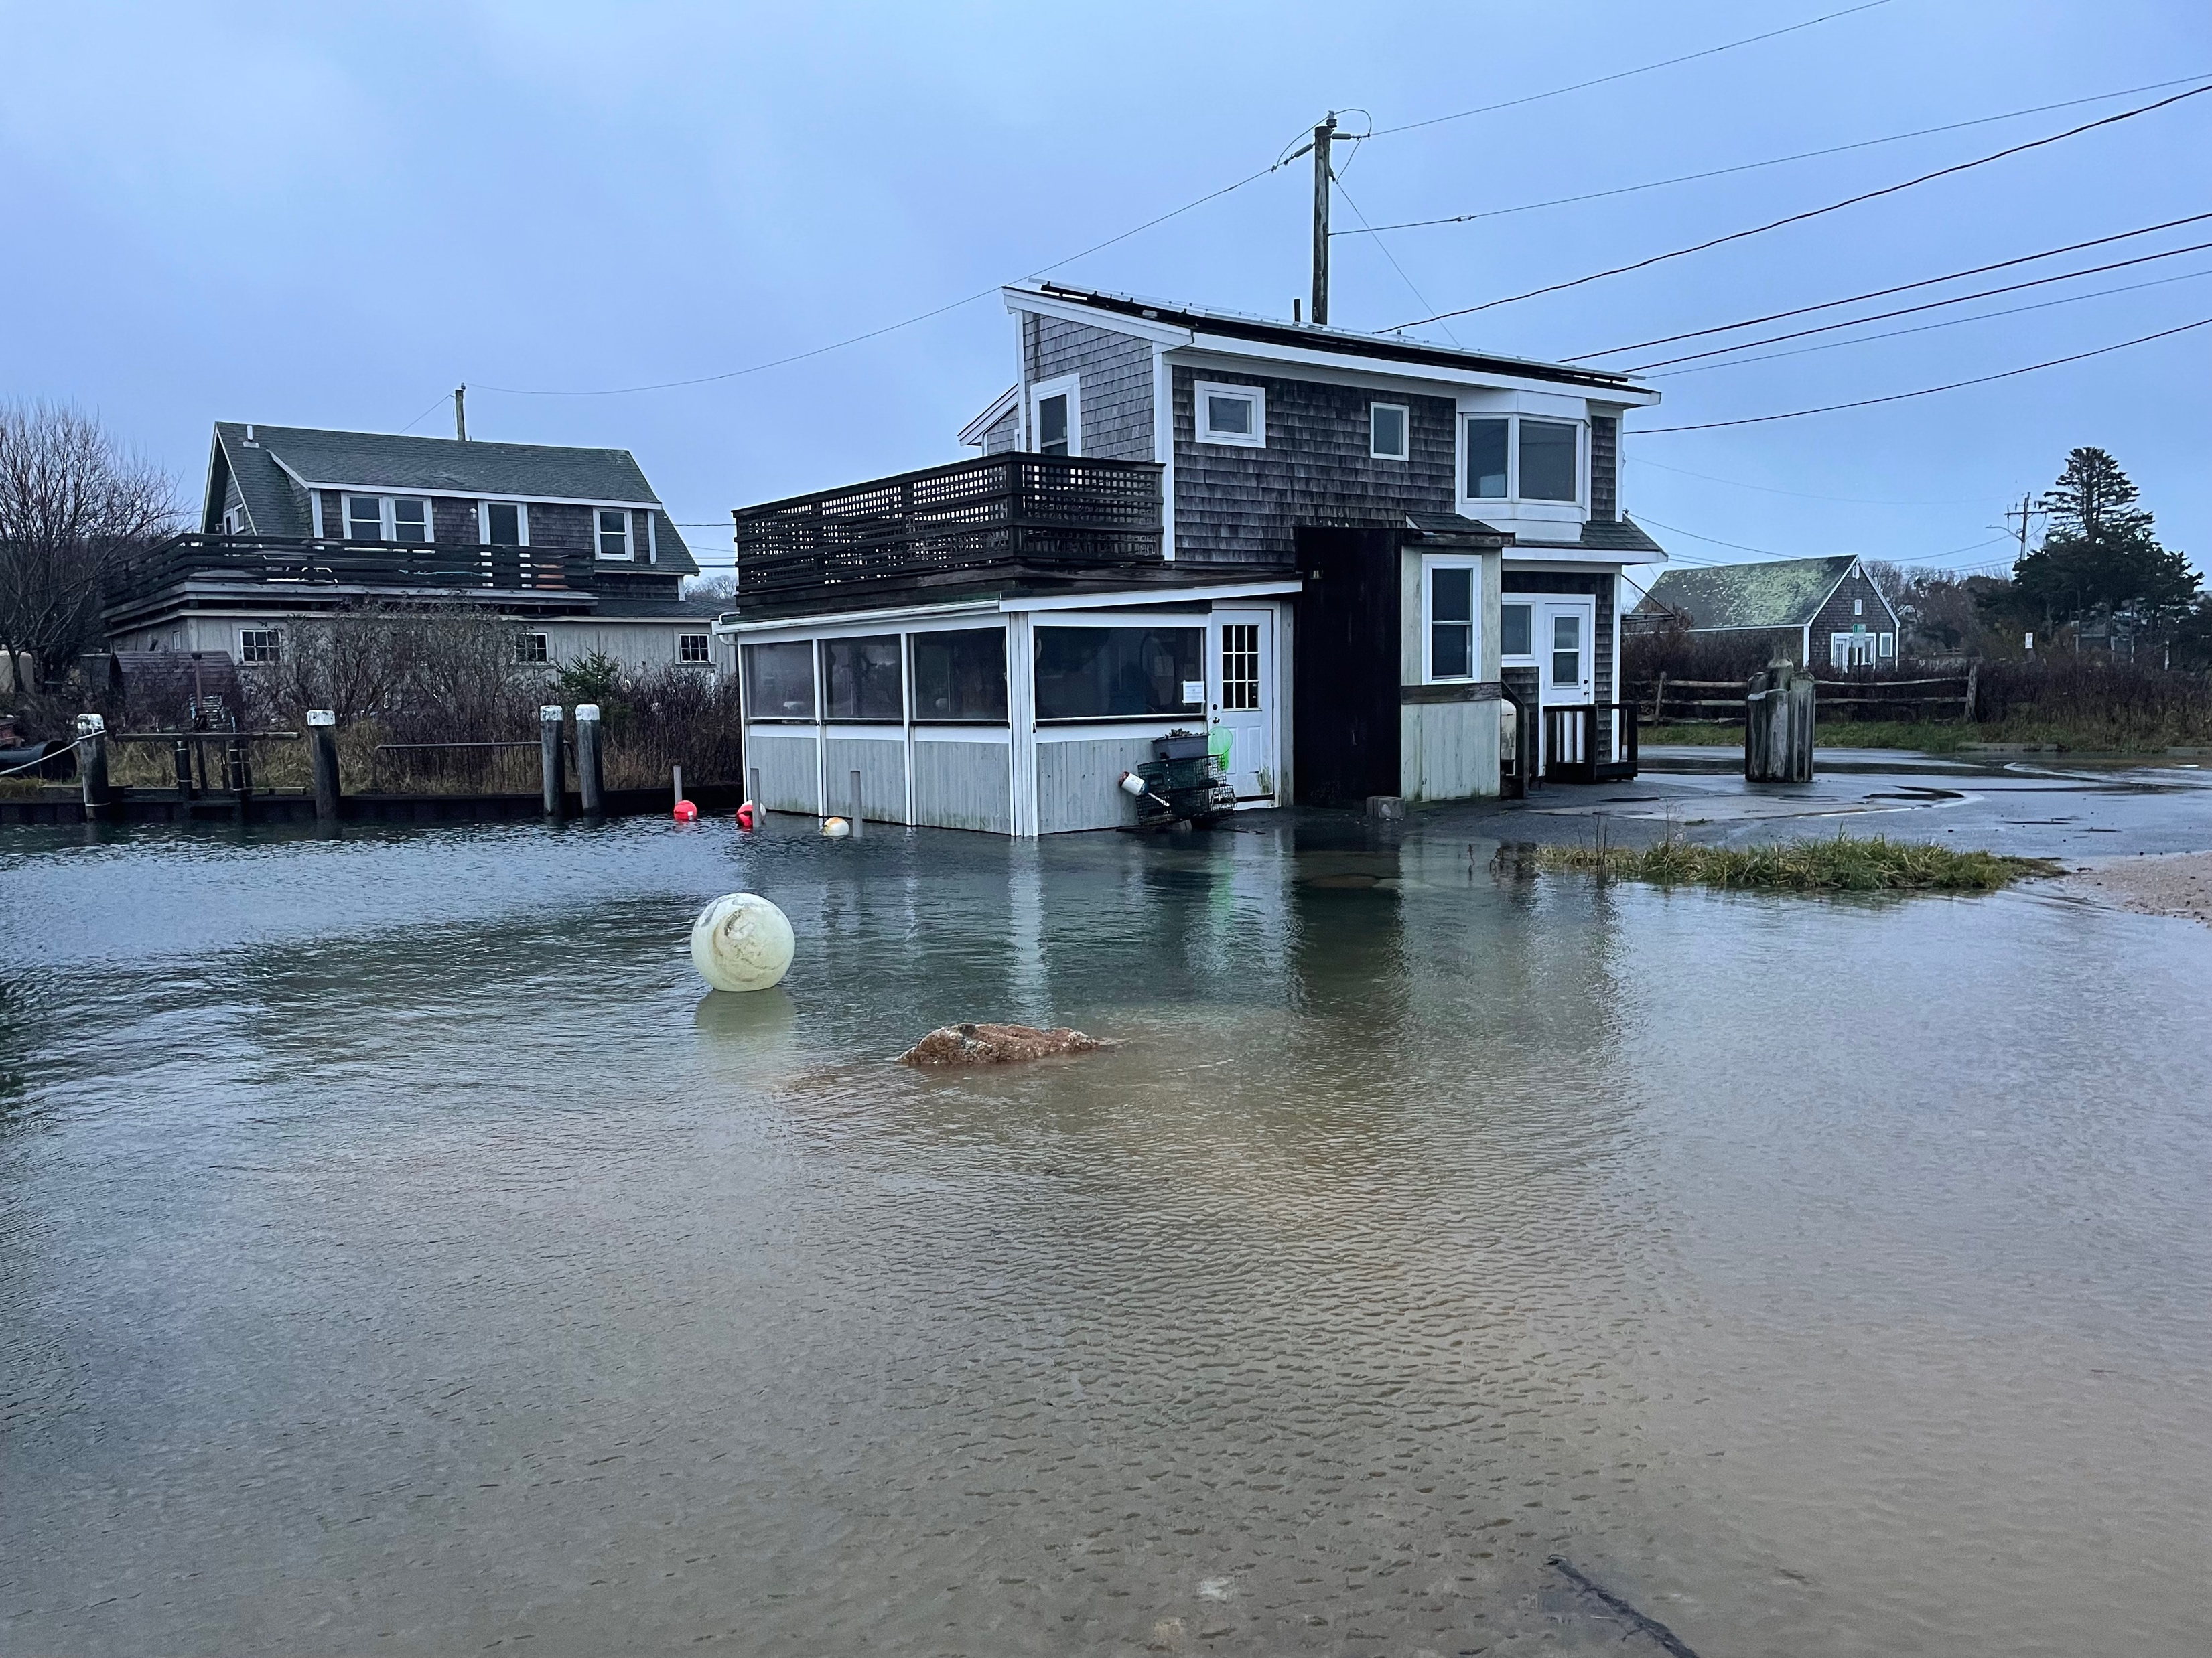
Menemsha photos by Marshall Carroll

Slide 4
In 2021 and 2022, all 6 island towns supported a non-binding resolution at town meeting that set goals of
Reducing fossil fuel use from a 2018 baseline--
50% by 2030
100% by 2040
And to increase the percentage of our electricity that is generated from renewable sources--
50% by 2030
100% by 2040

Slide 5
The goal of this document is to provide information to our island community about--
How we get our energy now and how we use it
What we can do to lessen our contribution to climate change
Ways islanders, businesses and larger entities can help
Information about the transition to all electric
Information about technologies and support that can help us reach our goals.

Slide 6
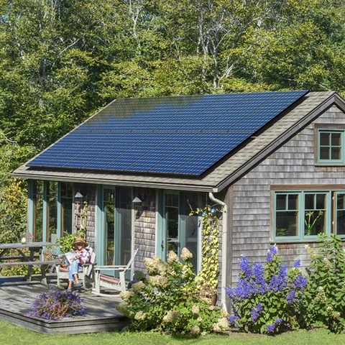
The MVC Energy Planner produced this document but there were many others involved who provided information, edits and additions to the document:
Vineyard Power
the Vineyard Sustainable Energy Committee
Eversource
The Steamship Authority
It builds on goals and actions laid out in the
MVC Climate Action Plan

Slide 7
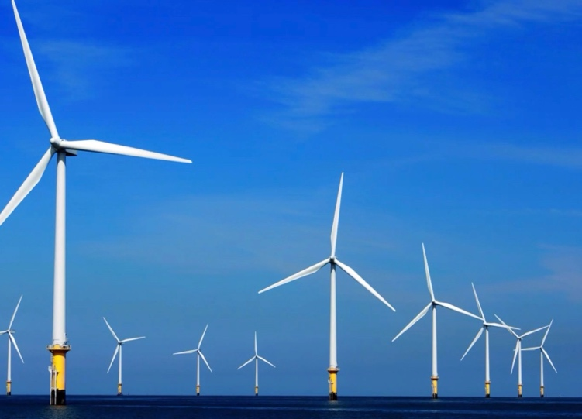
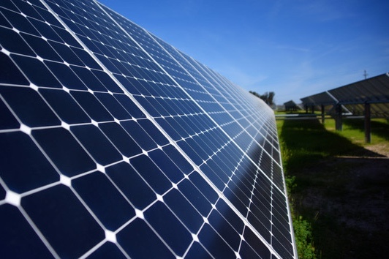
What does 100% Renewable mean for us?
Moving away from the use of fossil fuels by transitioning to all-electric from renewable sources.
A major shift in where our energy comes from, how we heat our buildings and hot water and how we get around.

Slide 8
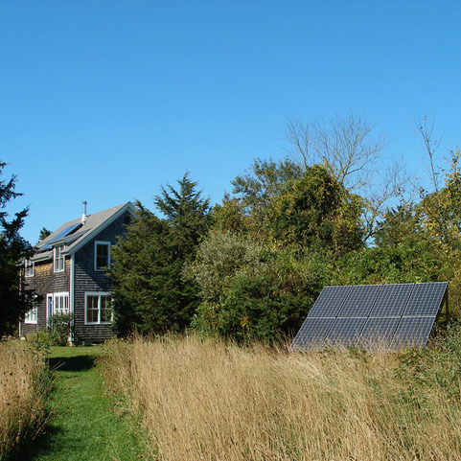
We have made great strides in the amount of renewable energy generated here.
We now have over 1500 solar arrays, producing 10% of our power annually.
We have a goal of increasing that generation to 15%.
We need grid modernization to meet our goals and to do our part to contribute to the State’s decarbonization goals for 2050.

Slide 9
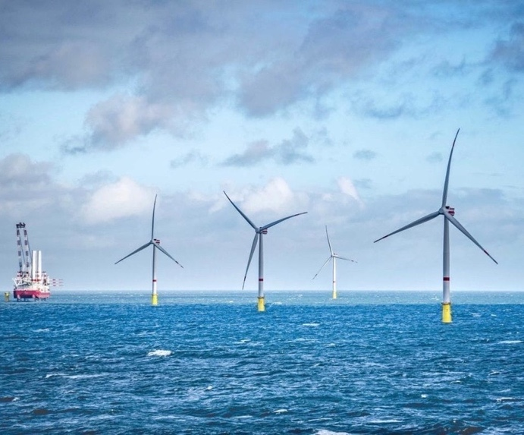
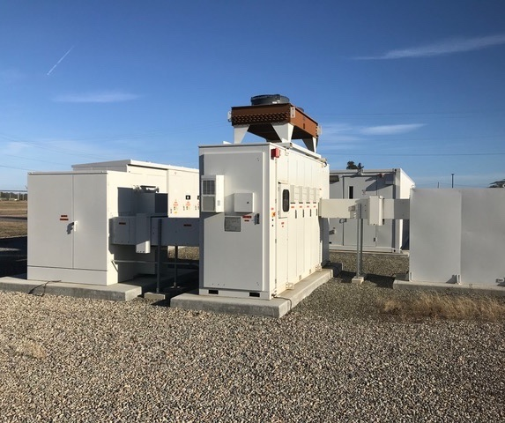
Getting our power 100% from renewable resources requires a greener electrical grid.
Page 4 tells you what powers our grid now and where we we are headed.
Offshore wind is one of the major strategies.
Large scale batteries are needed to provide power at times of peak demand.
Increasing the percentage of renewable energy that is in the Cape Light Compact’s electrical supplier’s portfolio is a way to accelerate this.

Slide 10
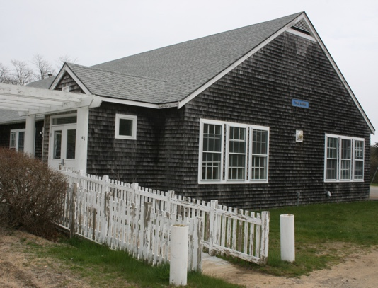
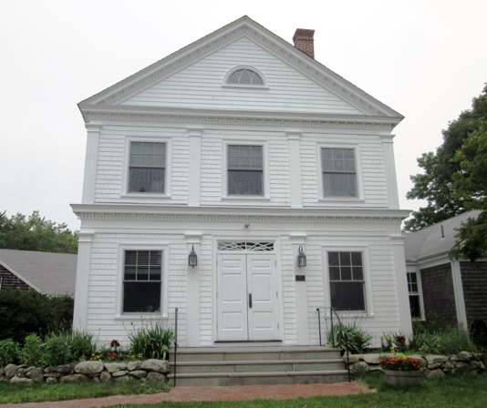
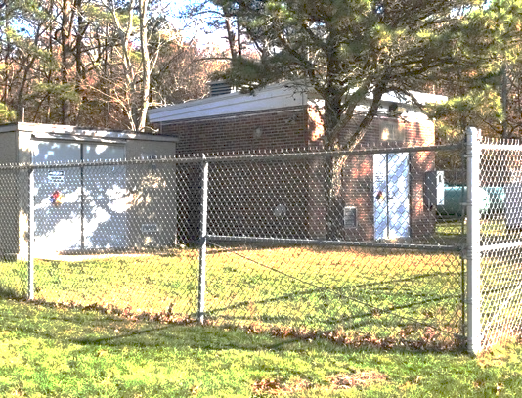
Batteries and solar to supplement generator power will also be needed to increase our resilience in the event of prolonged power failure.
Aquinnah and Chilmark have been working on designs for microgrids to provide back-up power for critical loads at town buildings.
A similar study is now underway to determine strategies for greater resilience at the down-island water departments and well sites.

Slide 11
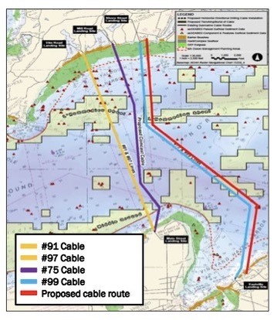
One of the concerns is –
Is there enough power for people to transition to all-electric?
Eversource will be installing 2 new cables in 2025—one is new, one is a replacement.
They predict that this will provide 140% of the power we will need in 2050.

Slide 12
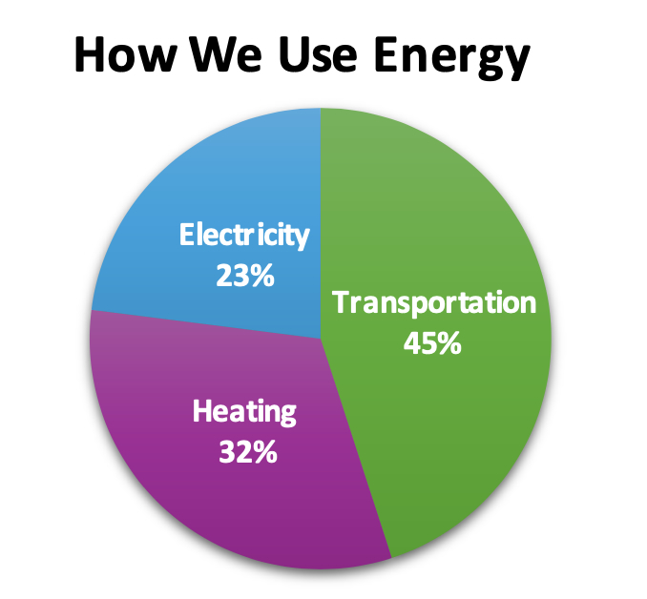
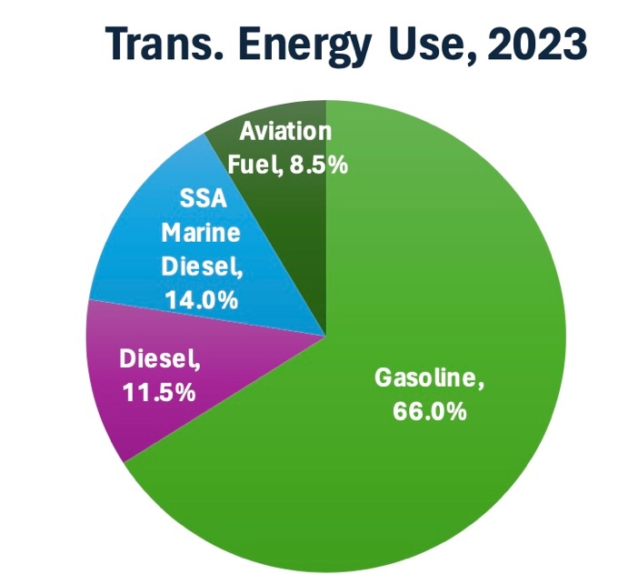
On Page 8, you will see information about our energy use.
45% of our fossil fuel energy use is for transportation.
We are installing greater numbers of heat pumps here and EVs are slowly being adopted but we are not yet on a significant downward trend.

Slide 13
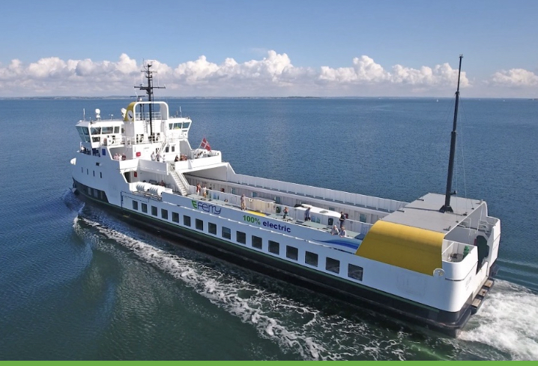
The ferries are 14% of our transportation fossil-fuel usage. Ferries Now was a year ago.
The Steamship Board has approved $750K for the design of a hybrid “Woods Hole” ferry.
Their strategic plan calls for a formal plan for vessel replacement that incorporates hybrid conversion or acquisition and resilient design principles at the terminals.
We will need a plan for shoreside charging infrastructure for ALL ferries that come to the Vineyard as well as plans for greater resilience at all ports.

Slide 14
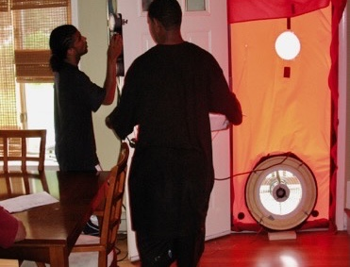
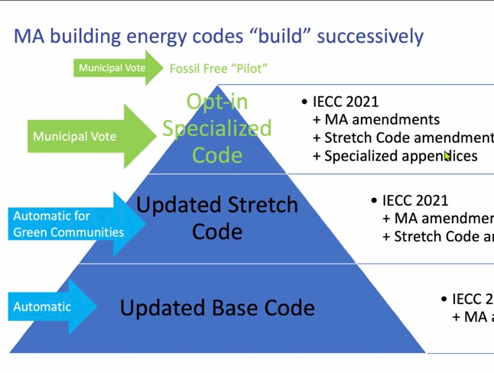
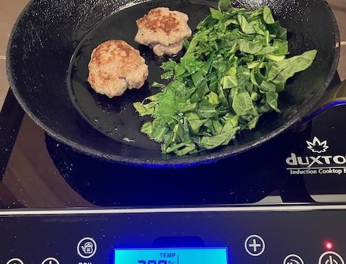
How can WE meet the 100% goal?
1. Reduce carbon emissions
Transition to a 100% Carbon-Free Electrical Supply
Offshore Wind
Capture and Store Carbon
2. Increase local energy generation and resilience
Solar
Storage
Make our Electricity Supply Resilient
3. Reduce energy use in buildings
Insulate and tighten up building envelopes
Adopt the most energy-efficient Building Codes
Invest in training a skilled workforce
4. Transition building energy use to all-electric
Electrify heating, hot water and cooking equipment
Heat pumps, hybrid electric water heaters
Induction stoves

Slide 15
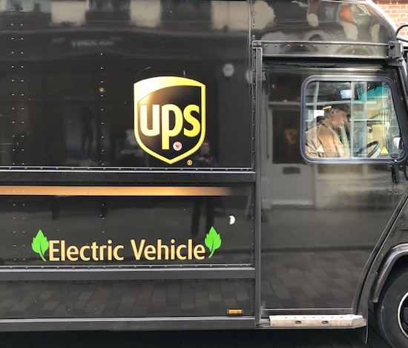
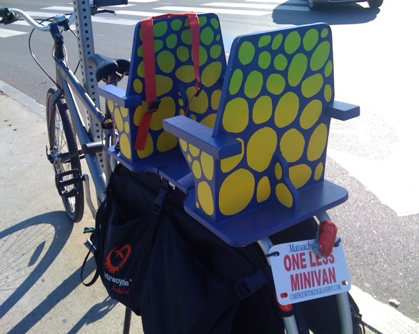
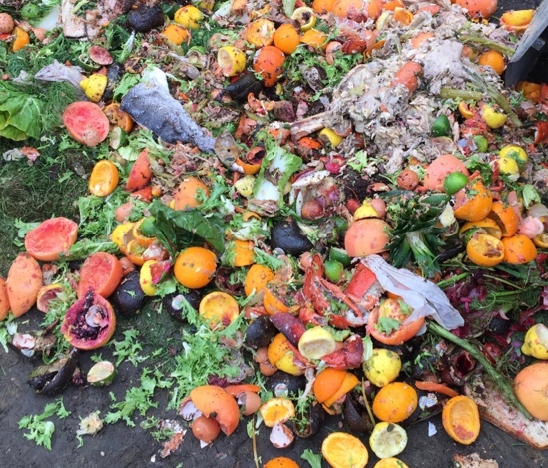
Continued…
5. Electrify all manner of vehicular travel (and machinery)
Cars, trucks
Buses, delivery vehicles
Ferries, planes
Provide electrical charging infrastructure
6. Reduce our transportation energy use
Increase bus and Park & Ride usage
Develop a safe island-wide network
of bike and walking paths
Reduce waste and shipment of waste

Slide 16
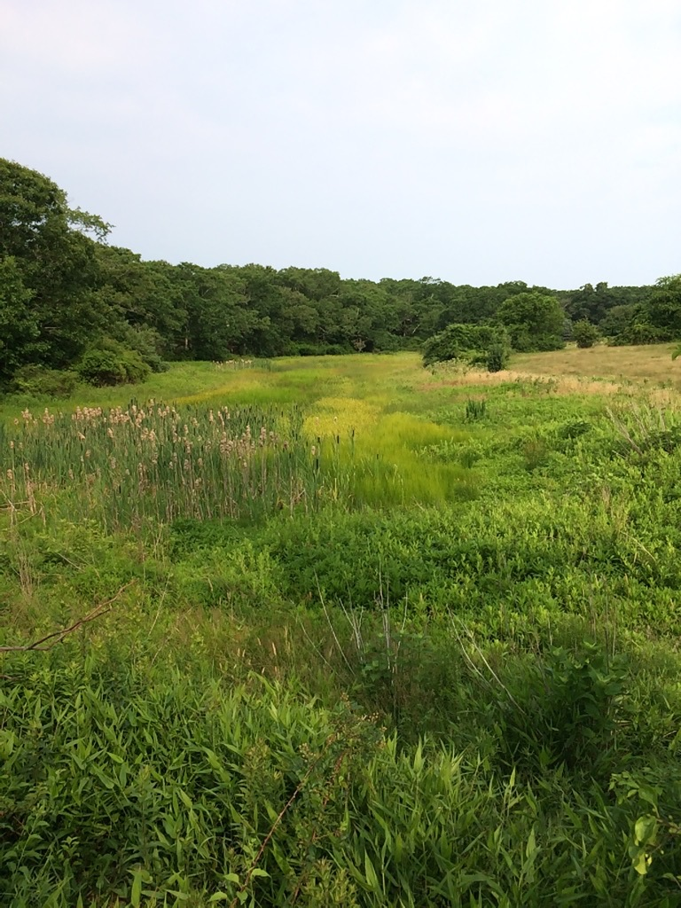
How can the Towns help now?
Develop a roadmap for how to decarbonize your town buildings
Consider adopting the Specialized Code
and a ZEV policy for future acquisitions
All of these actions are part of the Green Communities Climate Leaders program
Help to develop a safe network of bike paths
Consider the idea of island-wide composting
Help spread the word to your citizens about ways to transition to all-electric

Slide 17
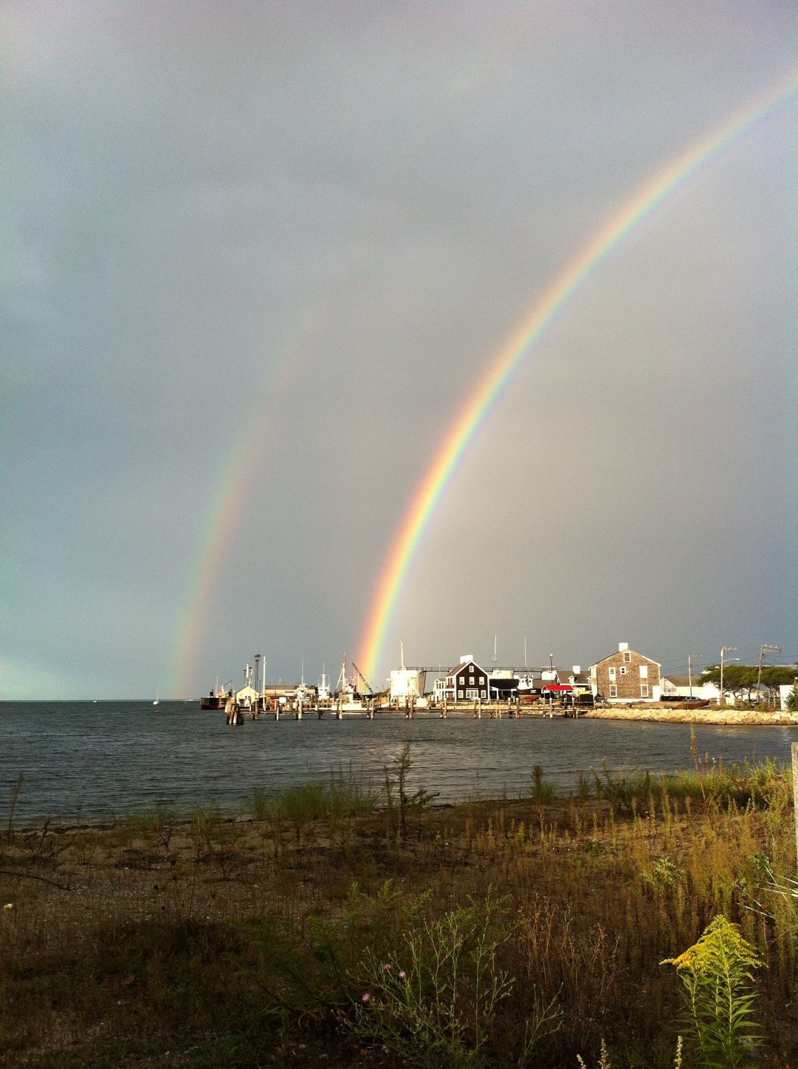
The time to act is now.
We have the knowledge and tools we need to accomplish this transition so that future generations can enjoy life on Earth.
Our non-binding resolution goals are
50% reduction in fossil fuel use by 2030
100% by 2040.
Making significant progress between now and 2030 is crucial.
I hope you will look further at this report and discuss how you, as Boards and individuals, can make this happen.

