Slide 1
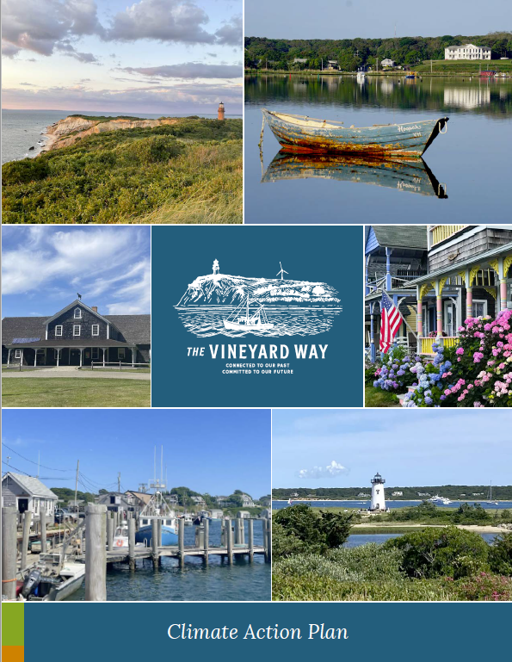


Climate Action Plan
Update
November 2023
Notes:
As a reminder our island community completed the Vineyard Way - Climate Action Plan a little over a year ago to identify and implement regional priorities to build our resilience to climate change and reduce our contributions.

Slide 2

Agenda
  CAP Implementation Updates and Challenges
  MVP 2.0
  NOAA Proposal
  Next Steps

Slide 3

Land Use, Natural Resources, and Biodiversity
  The Municipal Vulnerability Program grant awarded:
    Updated vegetation mapping of the Vineyard and Nantucket (Town Conservation Commissions, Sheriff’s Meadow Foundation, Polly Hill Arboretum, Vineyard Conservation Society, Martha’s Vineyard Shellfish Group, MV Land Bank, Trustees of the Reservations, Biodiversity Works, the Town of Nantucket)
    Map eelgrass in Lake Tashmoo, Lagoon Pond and Sengekontacket Pond to help identify future aquaculture sites (MV Shellfish Group, Great Pond Foundation)
    Focus groups with the landscape community to understand the barriers and opportunities for climate resilient and native landscaping (BiodiversityWorks, Polly Hill Arboretum, and Vineyard Conservation Society, Vision Fellowship)
    Planning and coordination support for a 2024 Climate Action Fair including support for a Brazilian Community Event
  MVC has drafted a MVC DRI Policy for flood risk areas
  Vineyard Vision Fellow and the MVC began a study of the local production and applications of bio- char

Slide 4

Transportation, Infrastructure, and Waste
  MVC Task Force began phase one of a supply chain/carrying capacity study with a focus on water-related components
  An MVC liaison attends monthly Steamship Authority meetings and subcommittee meetings to learn of and update the MVC on SSA climate-related matters
  The Construction and Demolition Waste Committee and Vineyard Vision Fellowship implemented and documented a pilot project on reclaiming waste from a renovation project
  The SSA has upgraded the OB pier and added three freight boats to increase life-span 25 years.
Notes:
MVC Task Force began phase one of a supply chain/carrying capacity study with a focus on water related components through a Planning Assistance for States (PSA) agreement with the Army Corps of Engineers- Engineering and Research Development Center.
The Construction and Demolition Waste Committee and Vineyard Vision Fellowship implemented a pilot project on a house going through a major renovation to harvest a significant portion of the materials that normally would have gone to the transfer station. This project was documented and will be used in future reclamation projects and training
An MVC liaison attends monthly Steamship Authority meetings and subcommittee meetings to learn of and update the MVC on SSA climate-related matters

Slide 5

Energy Transformation Highlights
  Vineyard Power/Cape Light Compact (CLC) pledged to donate up to $200,000 a year for CLC to distribute among income eligible ratepayers. This donation aims to deliver savings totaling between $300-400 every year.
  Since 2022, Cape Light Compact has supported the installation of 33 heat pumps and 21 heat pump hot water heaters for low income residences
  Vineyard Power conducted over 60 outreach events and launched an Energy Coach program on solar, EVs, and/or buildings. Have supported ~30 residents so far.
  Vineyard Power has become an Associate Member of the Martha’s Vineyard Builders Association to share resources and training
Notes:
Vineyard Power and the Cape Light Compact (CLC) launched an initiative in September whereby Vineyard Power pledged to donate up to $200,000 a year for CLC to distribute among CLC income eligible ratepayers on Martha’s Vineyard. This donation aims to deliver savings totaling between $300-400 every year to income eligible rate payers.
Since 2022, Cape Light Compact has supported the installation of 33 heat pumps and 21 heat pump hot water heaters for low income residences
Vineyard Power conducted over 60 outreach events and launched an Energy Coach program that offers Vineyard residents easy to schedule, no-cost, 30-minute sessions with one of our coaches on solar, EVs, and/or buildings. To date, they have recorded approximately 30 coaching sessions. .
Vineyard Power has become an Associate Member of the Martha’s Vineyard Builders Association to share resources and training on Stretch Code modifications and new incentives from CLC.

Slide 6

Food Security Highlights
  IGI has secured a location in Oak Bluffs for a permanent home for the Food Pantry with plans for solar and battery back-up for energy resilience
  The West Tisbury farmers market is now able to process SNAP/HIP. SNAP is accepted year-round at Morning Glory Farm, and IGI Mobile Market and Norton Farm accept SNAP seasonally.
  With support from IGI, both the MV Hospital and Island Health Care have enrolled patients in Fresh Connect.
  Native seeds are now incorporated into the Community Seed Library!
  MVFPT received grants to purchase, process, and donate over 4,600 lbs of whole fish, 75 lbs of sea scallops, 110 lbs of lobster, and 760 clams to islanders in need.
  In 2022, the MV Tick Program is compiled training materials for new hunters and in collaboration with IGI donated and distributed 10 deer amounting to ~400 lbs of venison through the Island Food Pantry and other local food equity providers
  Cottage City Oysters is working with the Natural Resources Department in Tisbury to create new aquaculture/waterways regs that will provide gear storage lots.

Slide 7


Economic Resilience
  Vineyard Power is working with schools to discuss renewable energy and energy efficiency with a focus on career pathways for older students
  Vineyard Power is collaborating with ACE MV to explore the possibility of establishing an on-island certification/training program for HVAC installers.
  Through the MVC an initial analysis was drafted to identify funding needs and potential sustainable finance mechanisms that could be developed (e.g. fee for tourists).
Public Health and Safety
  A climate change sub-committee was established in the Dukes County Health Council to focus on the links between public health and climate change.
  A survey of healthcare providers and organizations was completed to understand knowledge and gaps in health impacts of climate change.
  Two public talks were carried out linking public health and climate change. One on air quality and one on PFAS
  Challenges with loss of leads or lack of engagement

Slide 8
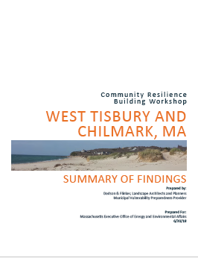
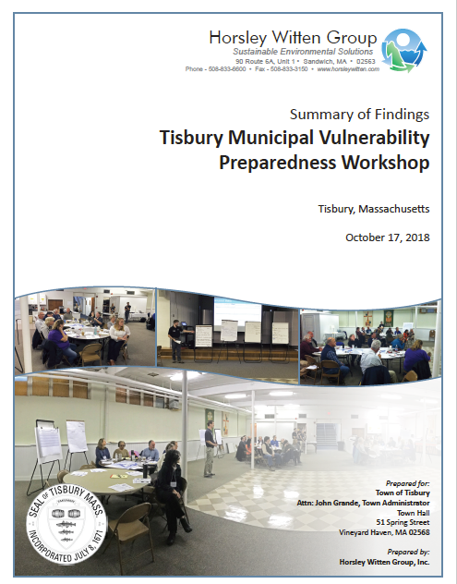
MVP 2.0
MA Municipal Vulnerability Program:
  Second Phase of Program
  Will build-off original MVP Workshops and Reports
  Review of Actions and Priorities with broader community engagement through funding and techncial support to engage more members of the community especially the most vulnerable or those with barriers to engage.
  Required Process for Future Funding for any towns whose report is 5yrs old or more. (Tisbury, West Tisbury, Chimark this year)
  Funding for contractor to facilitate, community engagement events and stipends. 50K to implement immediate action.
  MVC is working with your Town Climate Committees to review the process and approach....More Soon!

Slide 9
NOAA Regional Resilience Grant Proposal (IRA Funds)
  Letter of Intent Submitted and Approved for Full Proposal Submission
  ~600K to support three regionally important areas of MV:
      Vineyard Haven Harbor
      State Beach Rd (OB to Edgartown)
      Menemsha Harbor/Village
  Project would include:
      Long term vulnerability assessments including current use, interactions between sectors, future challenges
      Community visioning/goals and agreement on specific actions
      Output: Funding package development including: 1) action design, 2) budget, 3) possible funding streams, 4) community engagement summary
      Output: Framework for decision making (tool for future use)
      Technical Support and Training from NOAA
Notes:
Challenge in CAP – not able to address complicated areas important complicated areas
Over 800 LOIs submitted and only 120 asked to submit full proposals
Only 45 will be supported - 25 in our track.

Slide 10
NOAA Regional Resilience Grant Proposal (IRA Funds)
Full Proposal Due February 13. Support Needed from Towns:
  Proposal Development:
    Meet regularly with Town Administrator to be part of proposal development/ review to ensure town interests are represented and reflected, and
    Letters of Collaboration expressing commitment/ town engagement in the process and outcomes
  If awarded :
    The Town Liaison will be paid to be part of a Steering Committee for the Overall Project and to support coordination & communication for town/community engagement in their respective town/ priority area
    Town governments will need to be engaged to go through the process starting in June 2024- 2026.
Notes:
Over 800 LOIs submitted and only 120 asked to submit full proposals
Only 45 will be supported - 25 in our track.

Slide 11
THANK YOU FOR YOUR TIME & FEEDBACK!
Please keep checking back on our progress at:
www.thevineyardway.org
Notes:
23

