Slide 1
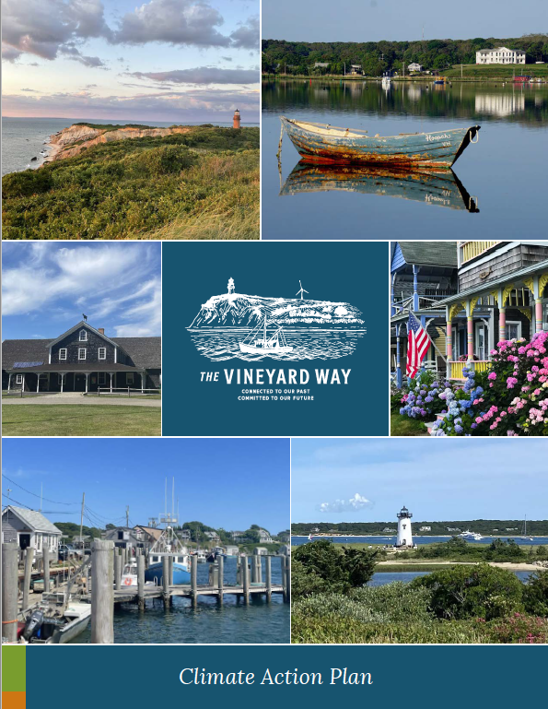
Climate Action Plan
October 2021 – August 2022

Slide 2
Today’s Objectives:
Thank you!
Share the final plan overview
Discuss town collaboration for implementation
Notes:
First we want to say thank you to you and all the town staff who participated throughout this process. This was a hugely collaborative effort and successful because of the dedication of everyone involved including a strong representation from the climate/energy committee(s) on our steering committee and many town staff/committee members on various working groups. We’re here to present the results of this effort and discuss our next steps and how we will continue working with your town into implementation. There’s so much in the plan so we’ll be showing you examples of various pages but we hope you’ll take time to look through it to get better feel for it.
MASTER PLANNING

Slide 3
Plan Overview
Land Acknowledgement
Executive Summary
What Motivates Us
MV Climate Emissions Baseline
Climate Hazards and Impacts
Climate and the Environment
Climate Equity
Engaging our Community
Timeline of Key MV Climate Milestones
Thematic Group Chapters
Overarching Goals
Moving Forward
Acknowledgements
Notes:
Here’s an outline of the plan. We’ll be walking mainly through the thematic group actions and ways for town collaboration. However we’ll show you various other components as we go through like this timeline of regional island climate milestones and this one which describes the tremendous community engagement through this process including 40 planning group meetings, presenting to 93 town staff to get feedback, 19 monthly outreach events, and climate action week with over 40 events and over 1400 participants.

Slide 4
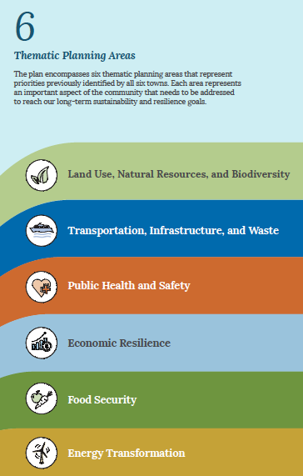
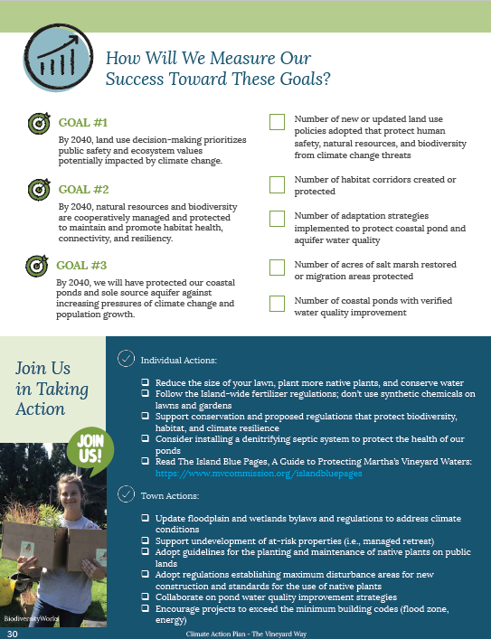
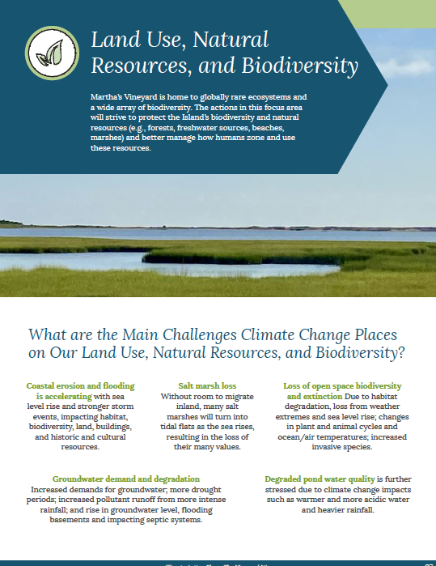
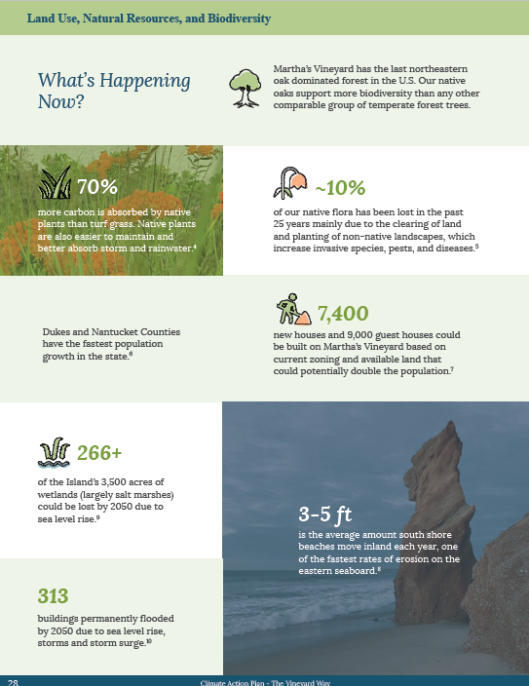
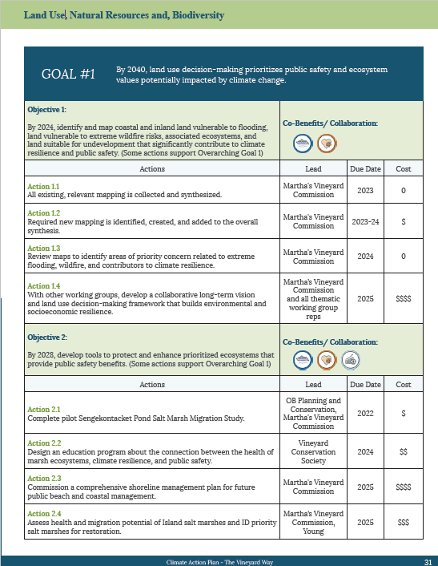
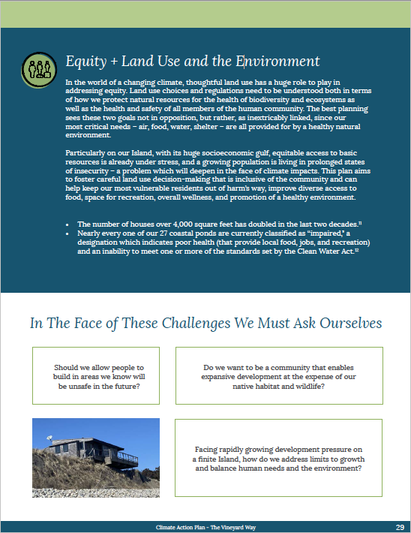
Thematic Planning Area Sections
Thematic Area Description and Climate Impacts
What’s Happening Now
Equity and Questions to Consider
Goals and Measures of Success
Objectives, Actions, Leads, Cost, Co-Benefits
Notes:
The bulk of the plan presents the thematic planning area sections. We had six thematic areas listed here and each section includes:
description and impacts of concern to the island
what’s happening now - such as 3-5 ft lost -
equity considerations and questions we need to consider as a community such as - should we allow building in aeras we know will be unsafe in the future?
what we want to accomplish by 2040 and how we’re going to track our success
All of our 3-10 year objectives, actions, leads, and general costs
Maybe here we provide some statistics that might hit home:
3-5 ft - average amount south short beaches move inland per year - Lucy/Squibby, South Beach considerations
7400 houses and 9000 new guest house could be built out with current zoning and available land
313 building will be permanently flooded by 2050 due to SLR and storm surge
28 critical facilities in the flood zone (hospital, ferries, packers fuel) and 3 of 4 access roads to hospital are in flood zone with 4th being inundated in cat 4 hurricane (BTW - we haven’t had a big hurricane since 1954 - so we’re due)
1700+ SSA cancellations due to bad weather from 2018 - 2020
19.4 million to export just food waste off island between 2020 and 2040
Only 4-7% of food we eat comes from the island and we only have about 2-day supply of food if there is an emergency

Slide 5
15 Goals
56 Objectives
191 Actions
Lead Organizations/Groups:
Ag Society, C&D Waste Committee, Vineyard Vision Fellowship. Cape Light Compact, Dukes County Emergency Managers Association, Dukes County health sub-committee, local CERT teams, Fire Chiefs, I2, Island Grown Initiative, Island Health Care, Kinship Heals, Morning Glory Farm, MV Center for Education and Training (formerly ACE MV), MV CLC Reps, MV Fishermen’s Preservation Trust, MV Shellfish Group, MV Food Waste Initiative Committee, MV Seafood Collaborative , MV Shellfish Group, Cottage City Oysters, MV Tick Program, Martha’s Vineyard Commission, MVC Climate Action Task Force, Polly Hill, BiodiversityWorks, President of Health Council, Prospective Emergency Manager, Steamship Authority, Town energy committees, Vineyard Conservation Society, Vineyard Power, Vineyard Sustainable Energy Committee
Town Collaboration: Climate & Energy Committees (on VSEC and CRC)
Notes:
Alot of government

Slide 6
Land Use, Natural Resources, and Biodiversity
Actions include
discontinuing or managing development in vulnerable areas (e.g., flood zones);
preservation of salt marshes for their many community values;
setting maximum disturbance limits for new development and standards for the use of native plantings; and
protecting coastal pond water quality and our drinking water through increased collaboration and enhanced regulations.
Town Collaboration for Implementation: Planning Boards, Conservation Commission

Slide 7
Transportation, Infrastructure, and Waste
Actions include:
planning for the protection or relocation of critical vulnerable roads that includes nature-based strategies,
collaboration with the Steamship Authority to build resilient port infrastructure,
assessing and addressing supply chain vulnerabilities, and
reducing solid waste and increasing self sufficiency (food & construction waste).
Town Collaboration for Implementation: Department of Public Works, Joint Transportation Committee Representative
Notes:
Review Actions

Slide 8
Public Health and Safety
Actions include
bilingual community outreach to the public and health care providers on health-related climate impacts and ways to reduce vulnerability (e.g., heat stress, wildfire, tick borne disease)
regional database of vulnerable populations
one or more regional emergency shelters stocked and staffed
development of an Island-wide emergency preparedness, response and recovery plan; and
implementation of the regional Community Wildfire Protection Plan.
Town Collaboration for Implementation: First Responders, Board of Health, Town Emergency Managers
Notes:
Review Actions

Slide 9
Economic Resilience
Actions for a resilient economic future include
assessment of vulnerable businesses and options for new economic conditions (diversifying the economy)
training residents for climate-related jobs,
assisting the transition of vulnerable businesses (fossil fuel-related businesses and those in at-risk locations)
encouraging businesses to adopt resilient and sustainable practices
Town Department Collaboration for Implementation: Finance Committee and Board of Assessors
Notes:
We will lose property and property tax income that we need to start thinking about.

Slide 10
Food Security
Actions include
improving Northeast-based supply chains that minimize risk of disruptions
developing standards for climate-friendly farming practices;
increase aquaculture production and local purchase of local seafood
ensuring that a consistent food supply will be in place for the food insecure and during emergencies;
increasing access to lands for the Indigenous community;
increased aquaculture production; and support for careers in commercial fishing.
Town Collaboration for Implementation: Shellfish Constable, Zoning Board
Notes:
Review Actions

Slide 11
Energy Transformation
Actions include:
increasing efficient electric home heating, the use of electric vehicles, and solar energy;
increase participation for energy transition assistance to low-and-moderate income residents.
microgrids and battery storage at critical facilities (working with emergency management);
advocacy for the transition of ferries to electric power;
collaboration with Eversource for sufficient electric grid capacity
towns develop plan for energy resilience with Island wide guidance
Aid in implementation of stretch code with outreach and training
Town Collaboration for Implementation: Building Department/ Inspectors, Select Boards, Planning Boards
Notes:
Review Actions

Slide 12
How this plan helps you:
Grant agencies look favorable on regional projects (that help us all)
One plan goal is to find sustainable funding
Access more technical resources and expertise that support town initiatives and public awareness
Collaboration on specific topics can reduce town staff workloads (e.g., updating floodplain bylaws)
Blueprint for island climate resilience that includes specific “town actions” that can be used for town planning (e.g., Master Planning)
How you can help with this plan:
Encourage and support your town staff and boards members to engage in regional collaboration on specific actions
Encourage your finance committee to begin considerations for town and regional climate funding needs
Notes:
Overview of Goals/Actions

Slide 13
THANK YOU FOR YOUR TIME & SUPPORT!
Please download the plan and keep checking back on our progress at:
www.vineyardway.org
Notes:
MVC (through Climate and Energy Planner positions) will coordinate and track implementation progress. Information and progress will be housed on the website where you can also download the plan.

