Slide 1
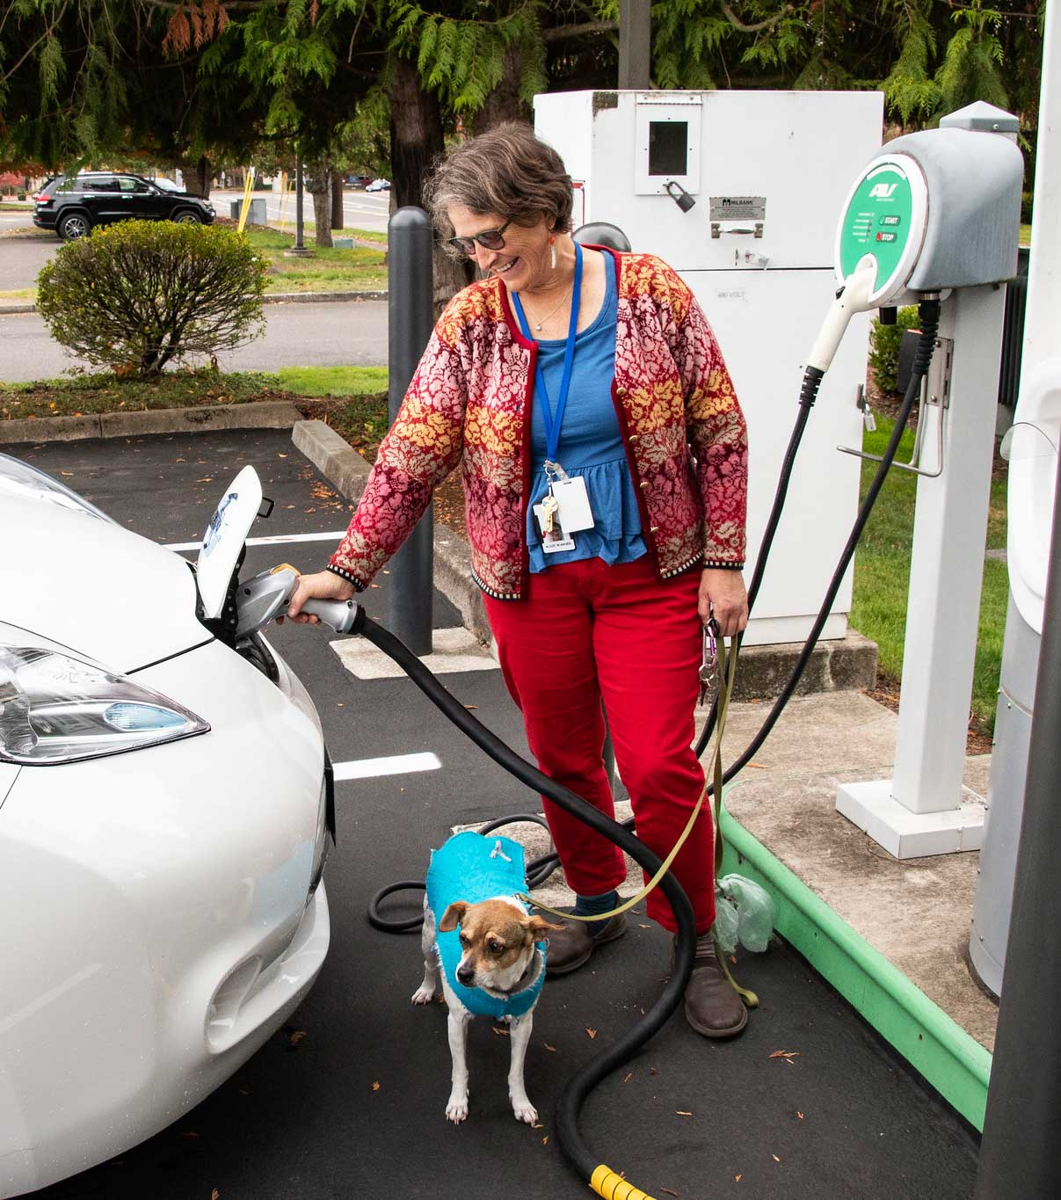
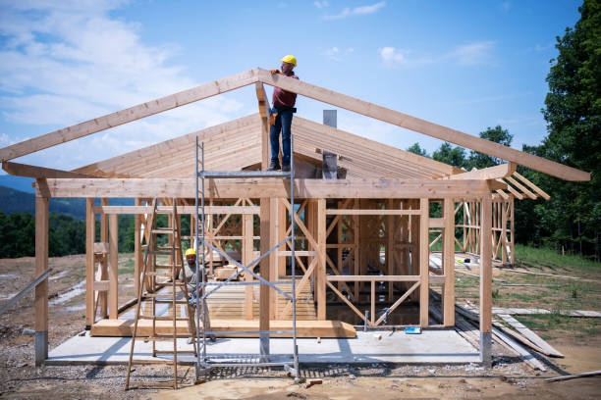
Adding Bylaws to Help Achieve Our 100% Renewable by 2040 Goal
West Tisbury Energy Committee
January 2022
Notes:
Testing

Slide 2
Our 100% Renewable Energy Goals
Reduce fossil fuel use on the Island, from a 2018 baseline:
50% by 2030
100% by 2040
Increase the fraction of our electricity use that is renewable:
To 50% by 2030
To 100% by 2040

Slide 3
How do we get there? Two steps--
Electrify! Convert things that use fossil fuels on the island to electricity (heating/cooling, transportation).
Get electricity from renewable sources (solar, wind).
We’re addressing step 1 today.

Slide 4
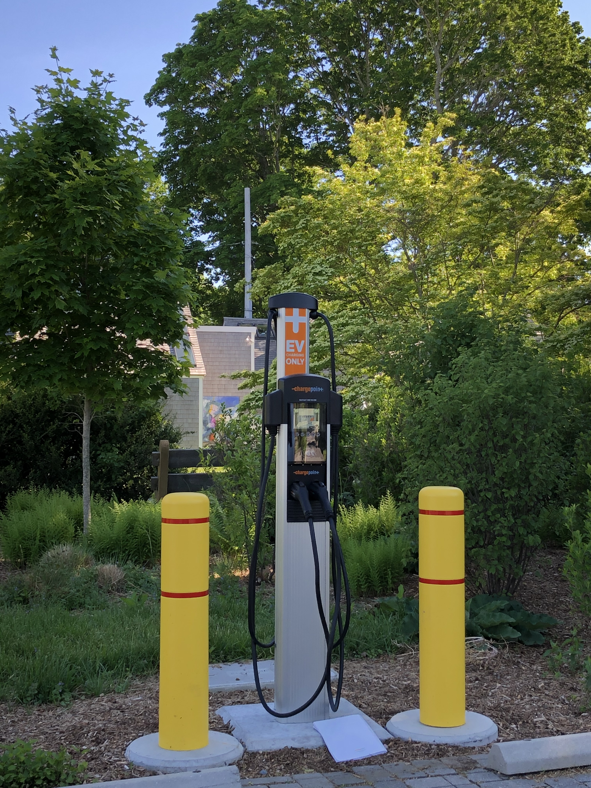
The Town is moving towards electricity for its energy use
We have 2 EVs being used by the Town Hall and 2 hybrids in the police fleet.
There are 4 places to charge EVs. The Library has the newest charger.
The Library and Police Station are our 2 all electric buildings.
We are beginning to work on a goal to make the School fossil-fuel free

Slide 5
Need to encourage our townspeople to electrify too
Tools to do this are:
Public outreach & education
Inform about incentives and rebates available for heat pumps and EVs
Bylaw changes

Slide 6
100% Electric bylaw: Require that all new construction and major renovations use electricity for heating, cooling, and hot water.
Houses last 50 years or more. We cannot meet our stated goal if we continue to build fossil-fuel dependent structures.
Starting with new construction makes the most sense as retrofitting is more challenging
Will using electricity be more expensive?
At a recent Statehouse hearing, it was said to be about a 1% increase
Operating costs are less.
Bylaw applies ONLY to new construction and major renovations

Slide 7
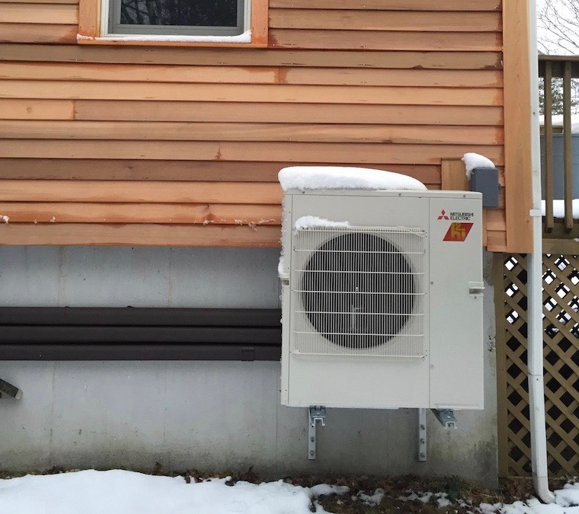
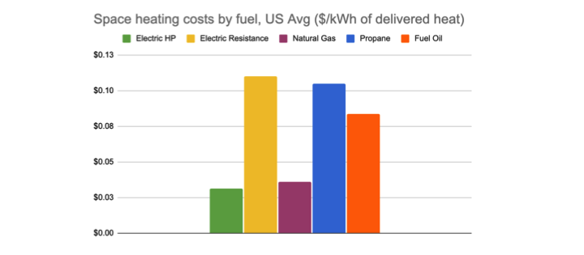
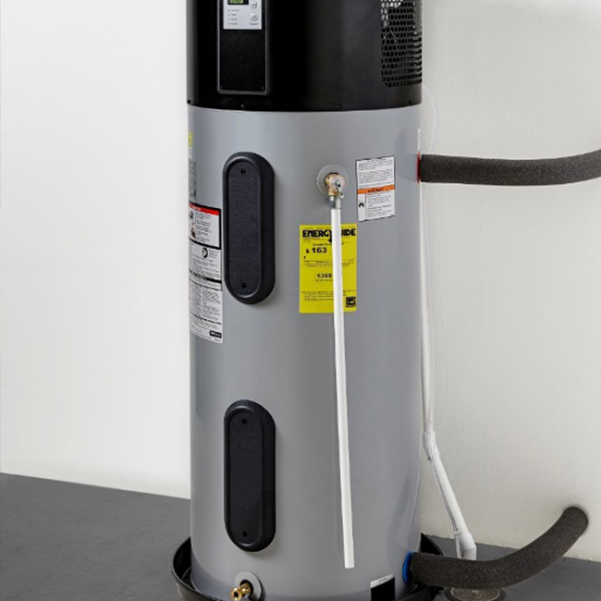
Comparative heating costs
epéedddddddddddddggdddddffffffffff
Rewiring America 4/21

Slide 8
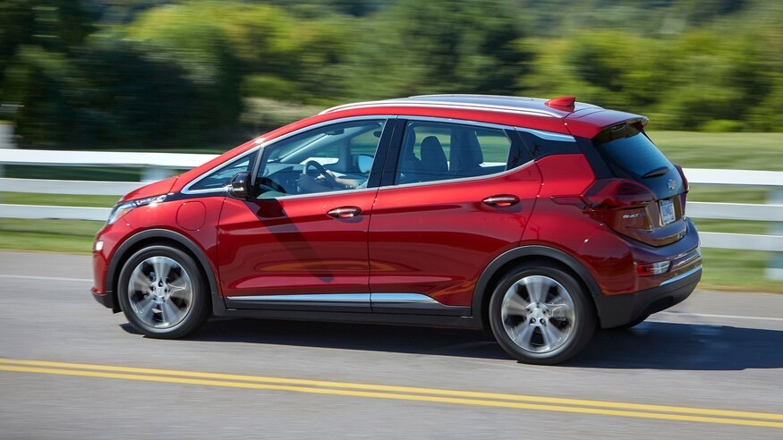
2. Require that all new construction and major renovations are ready for EV charger installation.
3+ years
Market forces now strongly favor electric vehicles
EV life cycle costs are significantly lower than fossil-fuel vehicles (energy cost, maintenance)
Several models exist at various price points, more each year
Charging on the island will typically be at home
Cost of installation less if done along with rest of the work

Slide 9
This bylaw will require a “Home Rule petition”
Brookline began this process and has been joined by Arlington, Lexington, Concord and Acton. Cambridge will soon file as well.
AG praised Brookline’s policy but ruled it was not within town powers. It is now being considered by the Legislature.
Aquinnah is leading the way on this on MV and will also consider this at their ATM.
AG
Rewiring America 4/21

Slide 10
This change could help move us toward our 2040 goals
The Energy Committee will present to Select Board on January 26
We will ask for this article to be included on warrant for April 12 Town meeting
AG
Rewiring America 4/21

